Slide 1
Ngā Tohu o te Taiao – Māori environmental indicators
Rangi weather and climate curriculum

Slide 2
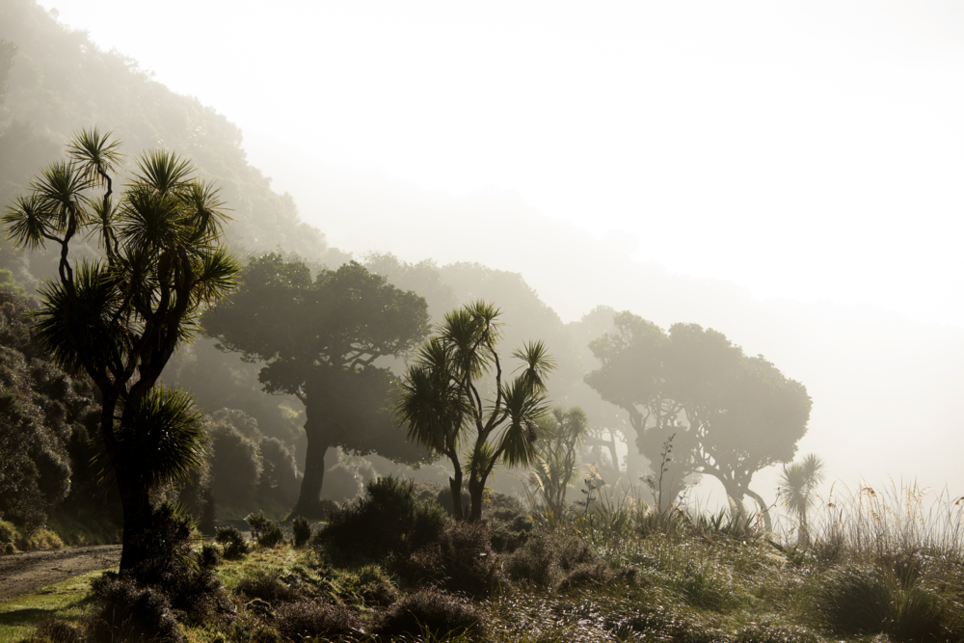
What are tohu?
Tohu are environmental indicators developed and used by Māori to signal, monitor and forecast changes in the natural environment.
These indicators help us make judgements about the health of wildlife, the time for planting and harvesting, and the management of risks such as crossing seas and local rivers.
Many of the tohu used by Māori are closely aligned with changes in local weather and climate conditions.

Slide 3
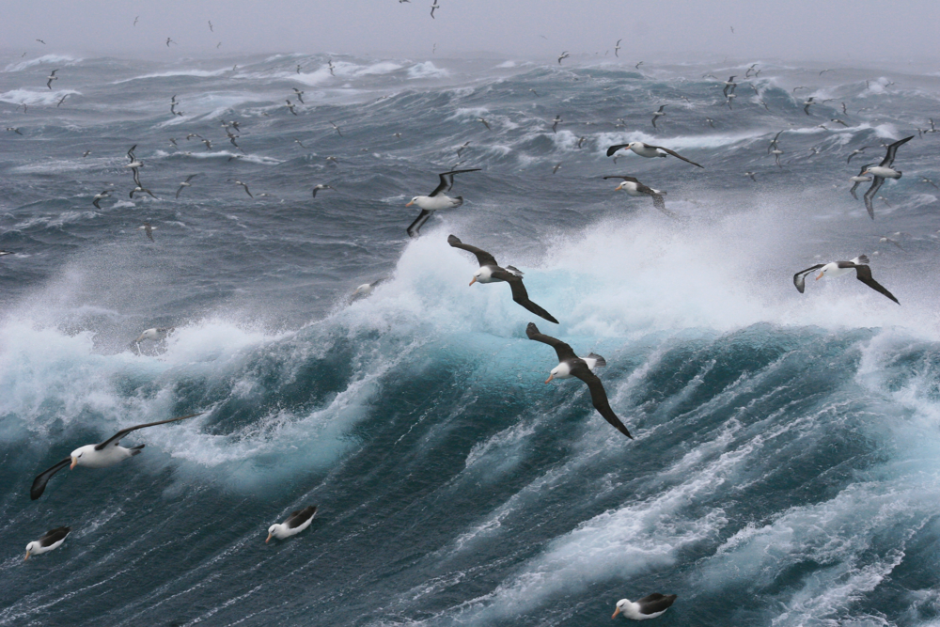
What are tohu?
The use of tohu comes from Te Ao Māori (the Māori world) principles that all things are connected through whakapapa (genealogy).
These whakapapa connections in the environment reveal much about what’s happening in our skies.

Slide 4
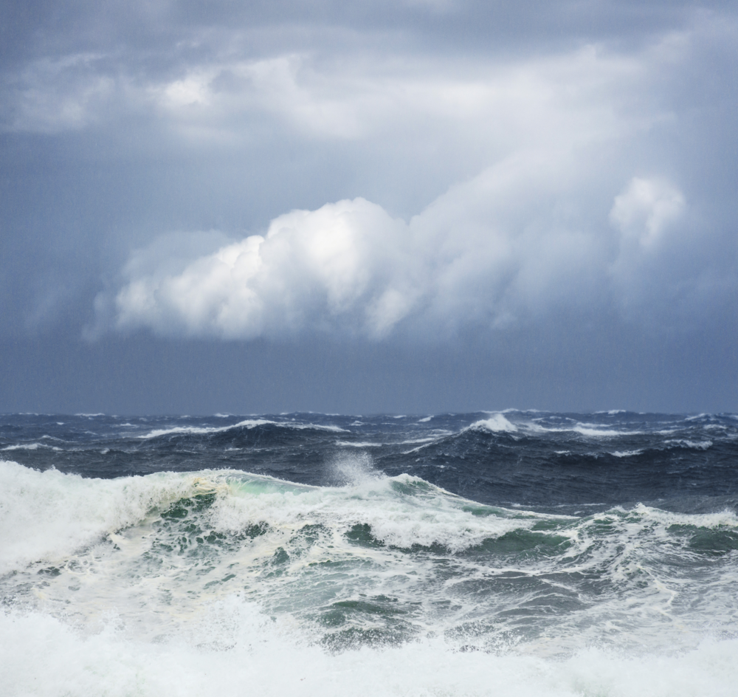
How were tohu developed?
Tohu were developed through close interactions with local environments and processes over time.
Māori learned and developed a detailed knowledge of the links between the natural environment and changing weather conditions based on careful observations of daily, monthly and seasonal conditions.

Slide 5
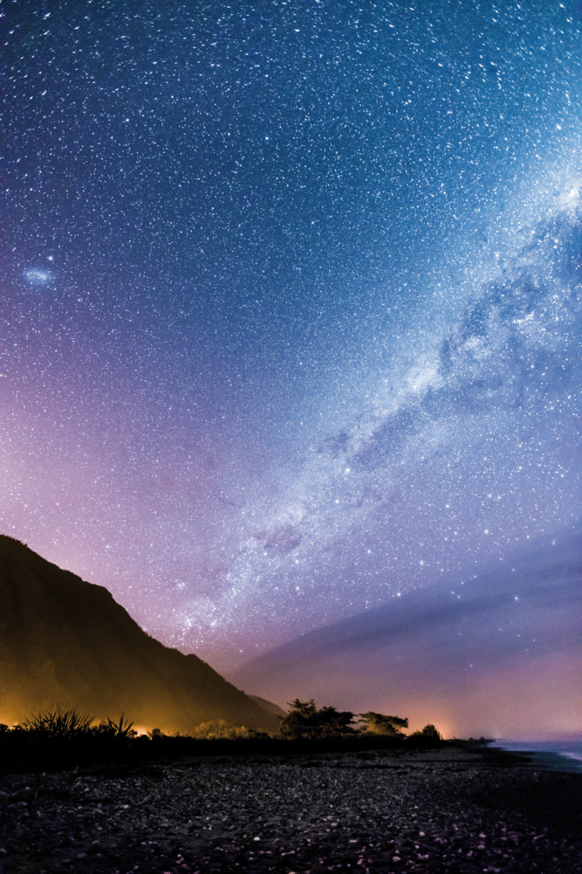
How were tohu developed?
These observations included the behaviour of certain birds, the blooming of certain trees and flowers, and the movement of certain stars.
For example, according to iwi from Te Wai Pounamu (the South Island) the appearance of an arch of dark clouds above the Southern Alps indicates forthcoming southerly weather conditions.

Slide 6
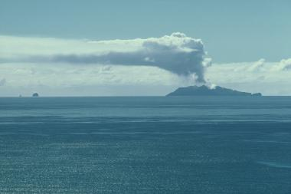
How are tohu used?
There are two key things to remember when looking for tohu.
Firstly, tohu are specific to a certain place or area. Each hapū and iwi developed tohu based on observations that are specific to their local environments.
For example, the shape of the plume of Whakaari/White Island is used by Te Whānau-ā-Apanui to indicate rainfall or extreme weather conditions. When you are looking for tohu it is important to be aware that a tohu used in one area may not be effective in another.

Slide 7
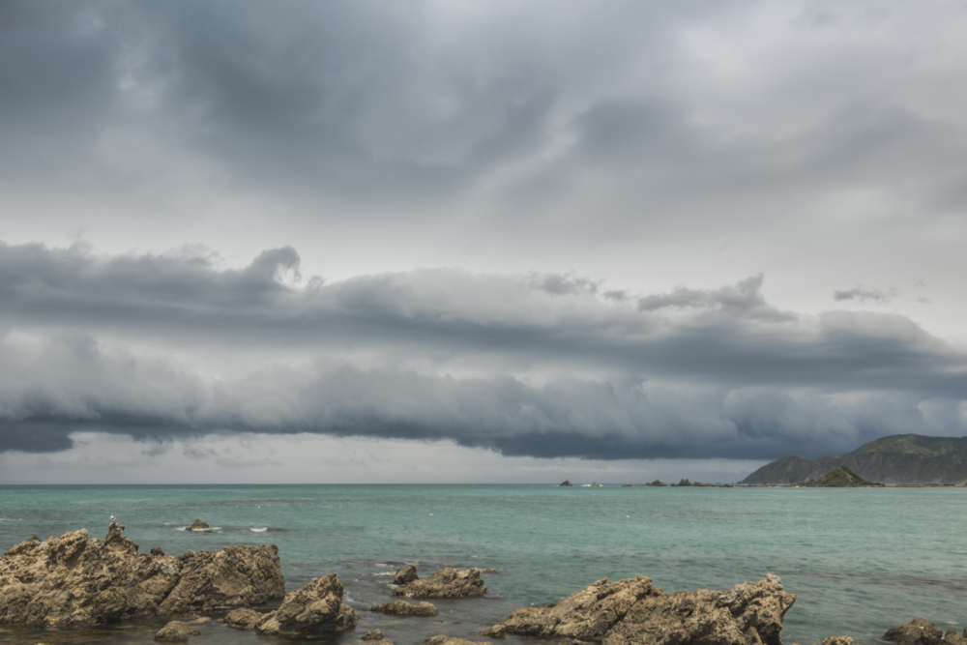
How are tohu used?
Secondly, a single tohu is rarely used on its own. To forecast the weather more than one tohu are usually used.
Multiple tohu used together can sometimes signal different expected outcomes. When this happens, forecasts are usually made based on what the majority of the tohu indicate.
However, in some cases there may be a known tohu that strongly indicates a particular outcome specific to that area. In this case the forecast will be made based on that one known tohu.

Slide 8
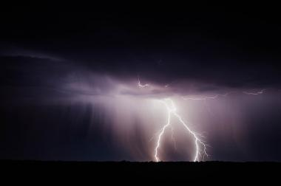
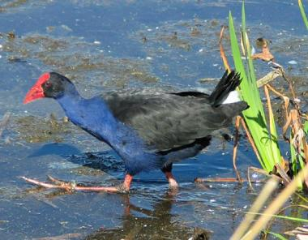
What are some examples of tohu?
 | Kōhara (Lightning) Indicator: Lightning flickering above the horizon. Expected outcome: The side on which the flashes are strongest signal the direction from which the wind will come. Iwi/Region: Kāi Tahu - E South Island
 | Pūkeko (Swamp hen) Indicator: Pūkeko head for higher ground. Expected outcome: Imminent storm and flooding. Iwi/Region: Ngāti Wai - NE North Island

Slide 9
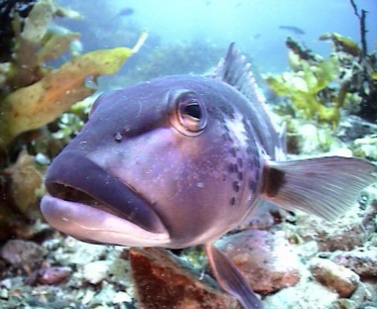
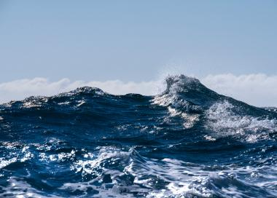
What are some examples of tohu?
 | Rāwaru (Blue cod) Indicator: Stones in the belly of the fish. Expected outcome: Bad weather is coming. Iwi/Region: Ngāti Koata - N South Island
 | Ngā ngaru (Waves) Indicator: The sound of breaking waves up the valley. Expected outcome: Approaching rainfall and inclement weather is expected. Iwi/Region: Te Roroa - NW North Island

Slide 10
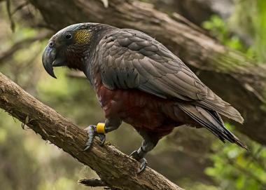
What are some examples of tohu?
 | Whakaari (White Island) Indicator: The plume lies to the left The plume flattens, and the end breaks off. Expected outcome: Rainfall is expected Watch out, extreme weather is expected. Iwi/Region: Te Whānau-a-Apanui - E North Island
 | Kākā (Native parrot) Indicator: Kākā begin acting up, twisting and squawking above the forest. Expected outcome: A storm is on its way. Iwi/Region: Ngāti Pare - NE North Island

Slide 11
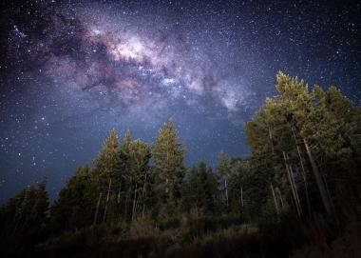
What are some examples of tohu?
 | Mangoroa (Milky way) Indicator: Mangoroa is curved. Mangoroa is straight. Expected outcome: Bad weather is expected. Fine weather is expected. Iwi/Region: Kāi Tahu - E South Island
Sources: King et al. 2007; Skipper et al. 2018

Slide 12
Glossary
Hapū: Sub-tribe Iwi: Tribe Te Ao Māori: The Māori world Te Ika a Maui: The North Island
Te Wai Pounamu: The South Island Tohu: Indicator or sign. Whakapapa: Genealogy, relationships between people or things

