Slide 1

Climate of Aotearoa
Rangi weather and climate curriculum

Slide 2
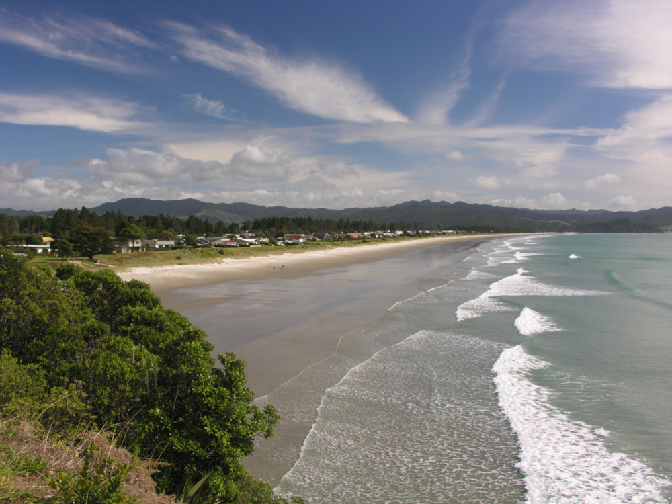
The climate of New Zealand is incredibly varied for a country of its size. The warm, sunny beaches and lush forests of Northland contrast sharply with the snow-capped Southern Alps and dry tussock fields of Canterbury and Otago. In this lesson, we’ll learn why New Zealand’s climate varies so much.

Slide 3
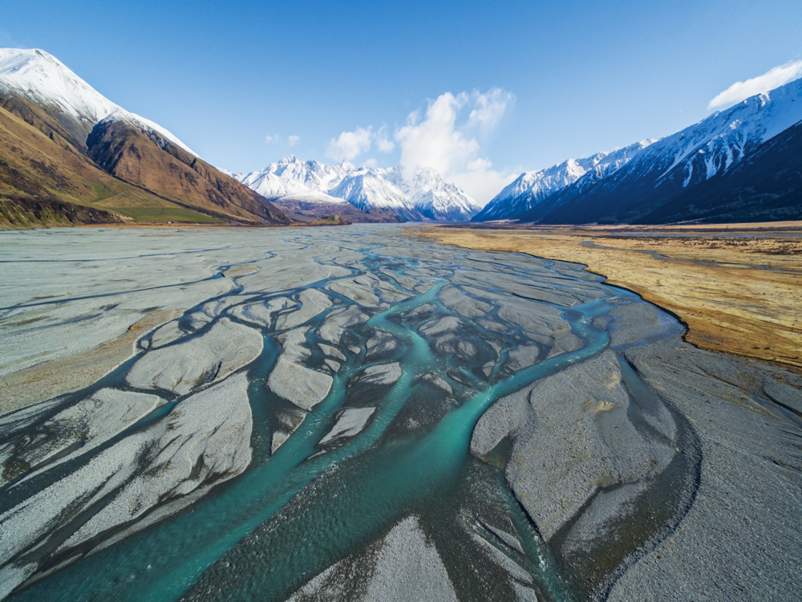
Aotearoa has a relatively wet, mild and windy climate. There are four pieces of the puzzle that are important for understanding New Zealand’s climate:
our temperate latitude,
the influence of the ocean
the prevailing westerly winds
New Zealand’s rugged topography (the shape of the land).

Slide 4
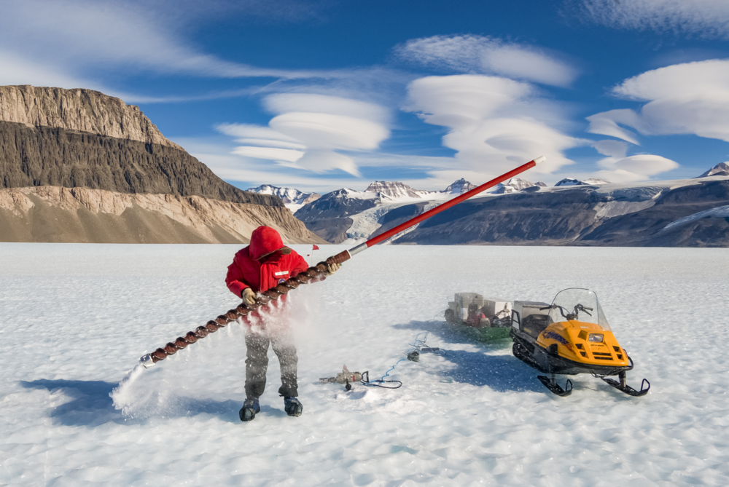
The latitude of a place, or how far it is from the equator, influences the climate a place experiences.
Close to the equator, the climate is generally very warm and humid, with lots of rainfall.
Further away from the equator, at the poles, the climate is generally very cold and snowy.

Slide 5
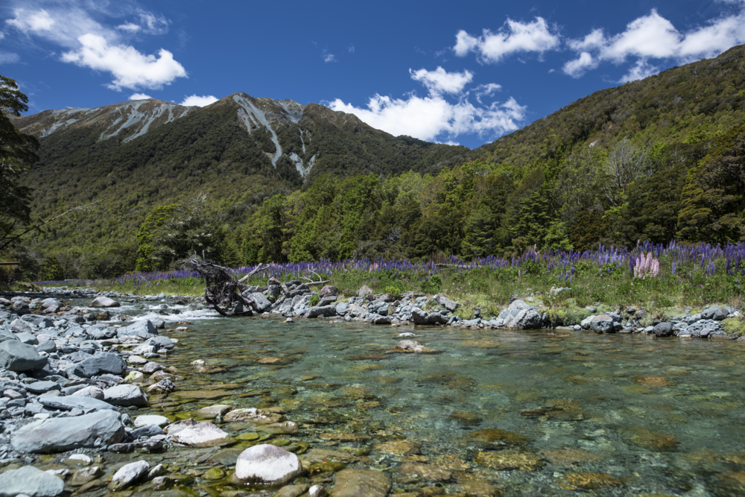
Aotearoa’s temperate climate
New Zealand sits about halfway between the equator and the South Pole, which means we have a temperate climate. This means our climate is more likely to experience moderate conditions.
Can you find other countries with temperate climates on the map on the next slide?

Slide 6
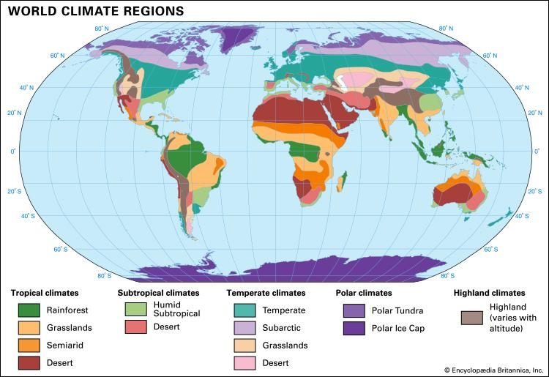

Slide 7
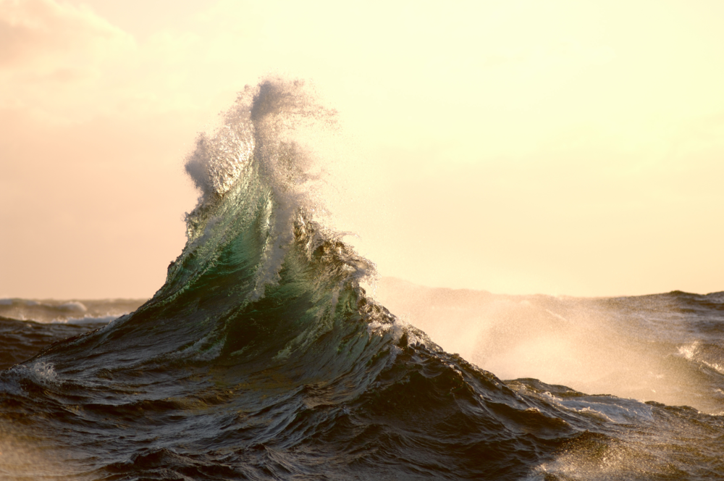
The influence of the ocean
The ocean surrounding New Zealand causes more moisture to be held in the air that travels across the country, bringing humid conditions and rainfall year-round. These oceanic air masses cause temperatures to generally be quite moderate (not extremely hot or cold).
Because New Zealand is surrounded by ocean, sea breezes ease temperatures and can cause cloudy weather to dominate.

Slide 8
Prevailing westerly winds
In the Southern Hemisphere, there is not much land to slow down the westerly winds, compared with the Northern Hemisphere where there are large areas of land to slow down the winds.
The strongest westerly winds that occur in the middle latitudes of the globe are called the Roaring Forties. These winds affect New Zealand!
Westerly winds bring air full of moisture towards the west coast of New Zealand, partly explaining why western areas are usually wetter than eastern areas.

Slide 9
NZ’s varied topography
When the prevailing westerly winds, carrying lots of moisture, reach the west coast of New Zealand, they are forced to travel up the side of the mountains because the mountains are blocking their path.
This is where we get an effect called 'orographic rainfall'. This means that as the air rises and cools, clouds form and rain (or snow if it’s cold enough) falls.
Most of the rain falls upwind (on the western side) of the mountain range and the downwind side (eastern side) of the mountain range is in what’s called the rain shadow where only small amounts of rain fall.

Slide 10
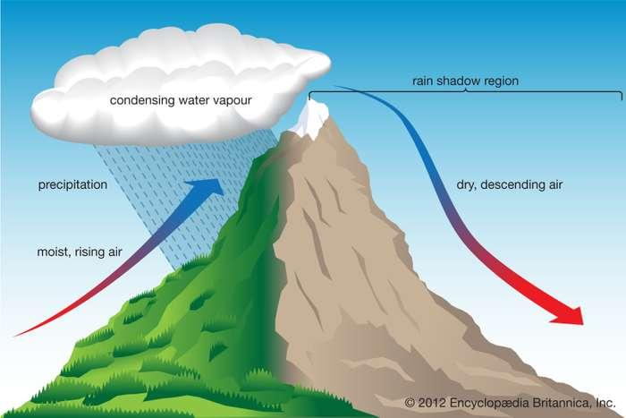

Slide 11
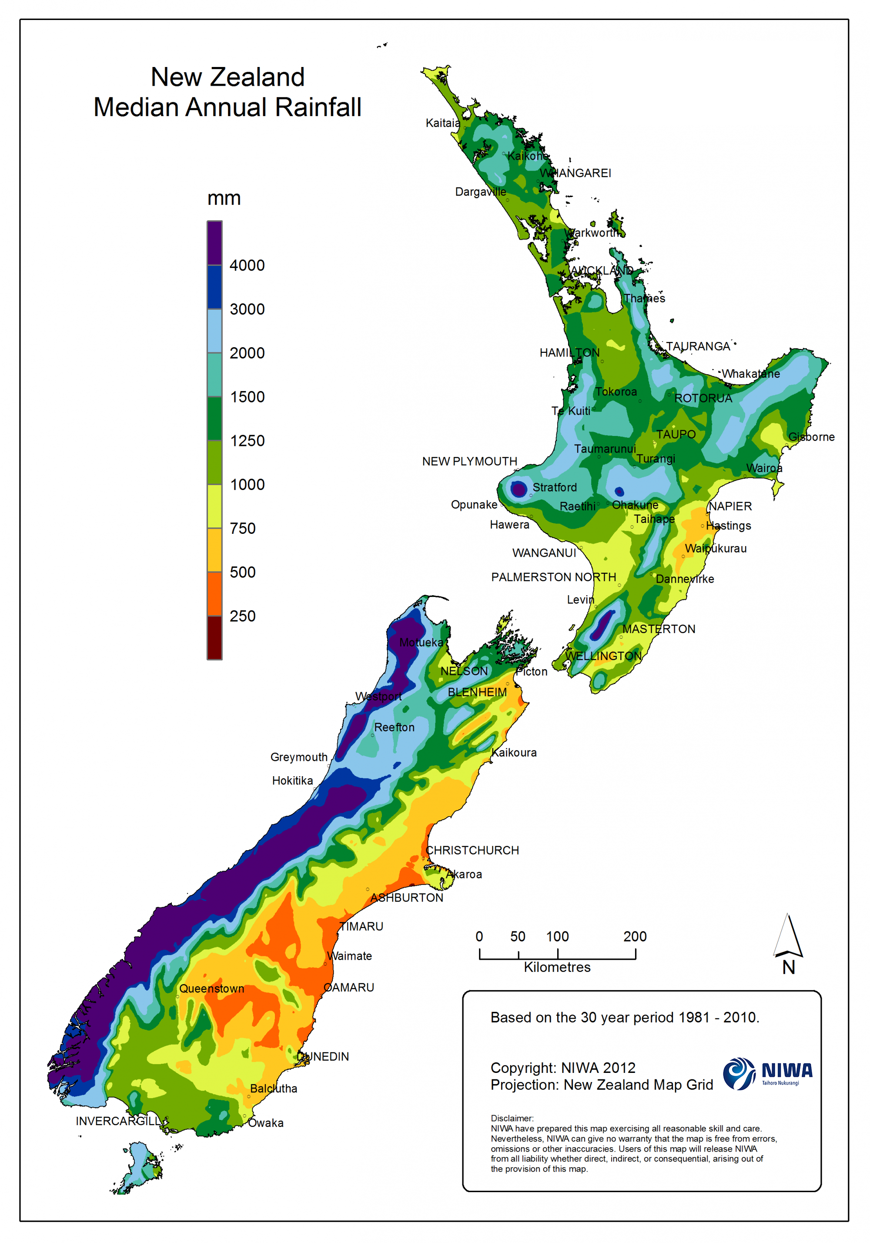
Rainfall patterns in NZ
The orographic effect is why we get very high rainfall on the west coast of the South Island in places like Milford Sound (almost 7 metres of rainfall a year!) but only about 100 km away, places like Alexandra in Central Otago only get on average 30 cm of rainfall a year. How crazy is that?!

Slide 12

Kahoot quiz: Climate of Aotearoa
https://play.kahoot.it/v2/?quizId=9cee17f9-0827-4c37-b304-26edc2df2817

