Slide 1
Climate drivers
Rangi weather and climate curriculum

Slide 2
What are climate drivers?
The summer of 2019-20 was the driest on record for much of Auckland. Summer 2017-18 and winter 2020 were the warmest on record for most of New Zealand. Autumn 2017 was one of the wettest, but spring 2014 was just average.
Have you ever wondered what makes the climate during one season more extreme than another? Such as why sometimes it rains, and rains and rains some more and other times it’s non-stop sunshine and beach weather? We’ll explore the reasons behind it in this lesson.

Slide 3
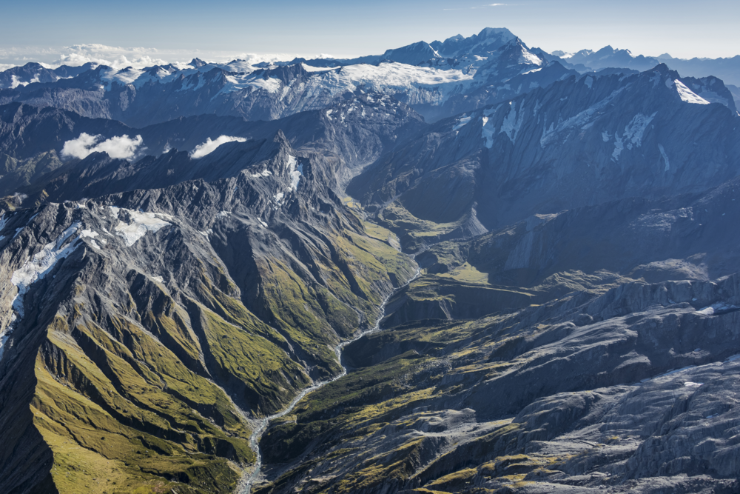
Climate represents the weather trends and patterns that are experienced in a location over a long period of time, such as months to years.
Global climate drivers influence weather patterns that occur over months and seasons.
You can think of climate drivers like pie. Each driver gets a piece of the pie, but depending on the season, a certain climate driver may get a bigger piece of the pie than other drivers. That driver would then have a bigger influence on the weather that occurs during that season.

Slide 4
Climate driver 1: The Sun
The sun is the main driver of Earth’s weather and climate patterns. The sun’s energy (solar radiation) isn’t equally distributed across the globe because of Earth’s spherical shape. This “unequal helping” of solar radiation across our planet is effectively what causes weather and climate.
Differences in solar radiation lead to differences in temperature and differences in temperature ultimately lead to stormy weather – storms are Mother Nature’s way of trying to minimise temperature differences.

Slide 5
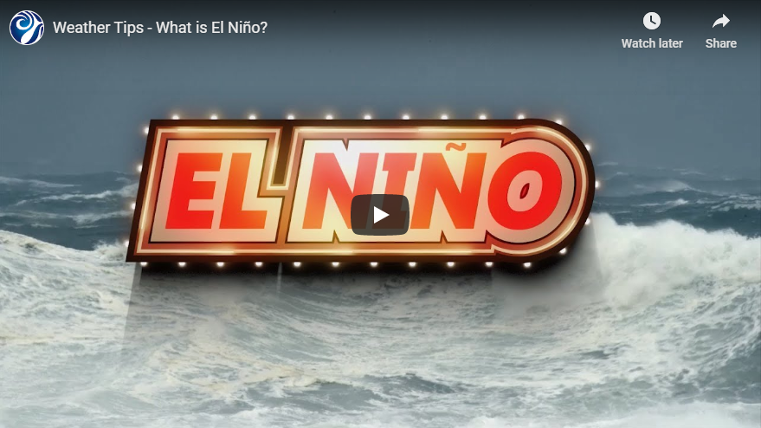
Climate driver 2: El Niño Southern Oscillation
El Niño Southern Oscillation (ENSO) is a climate pattern that influences rainfall, temperature, and wind patterns around the world. ENSO has three phases: El Niño, La Niña, and neutral. El Niño and La Niña events occur, on average, every few years and last up to around a year or two.
Watch this video to learn more about ENSO!
https://www.youtube.com/watch?v=A1r8ymAoe2M

Slide 6
Climate driver 3: Madden Julian Oscillation
The Madden-Julian Oscillation (MJO) is an eastward moving zone of cloud and rain that circles the tropical areas of the globe. It is the biggest driver of changing weather in the tropics and lasts a few weeks.
The MJO and its rain and thunderstorms are more likely to develop over an area that is experiencing warmer than usual ocean temperatures and less likely to affect an area with cooler than usual ocean temperatures.
The MJO can influence the formation of tropical cyclones. Typically one cyclone per year affects New Zealand!

Slide 7
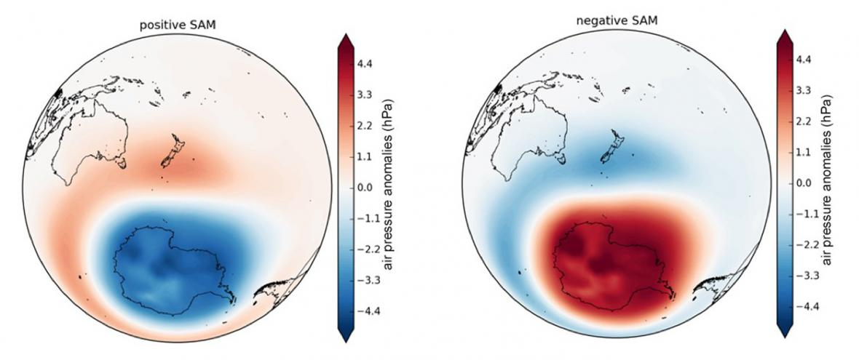
Climate driver 4: Southern Annular Mode
The Southern Annular Mode (SAM) involves alternating windiness and storm activity between the mid-latitudes, where New Zealand is located, and higher latitudes, such as over the Southern Ocean and Antarctica.
There are two phases of the SAM: positive and negative. In short, when the SAM is positive, the weather is more likely to be nice across Aotearoa.

Slide 8
Kahoot quiz: Climate drivers
https://play.kahoot.it/v2/?quizId=2bacf573-b1f9-428f-bd50-bc0e01e767ae

