Slide 1
Severe weather
Rangi weather and climate curriculum

Slide 2
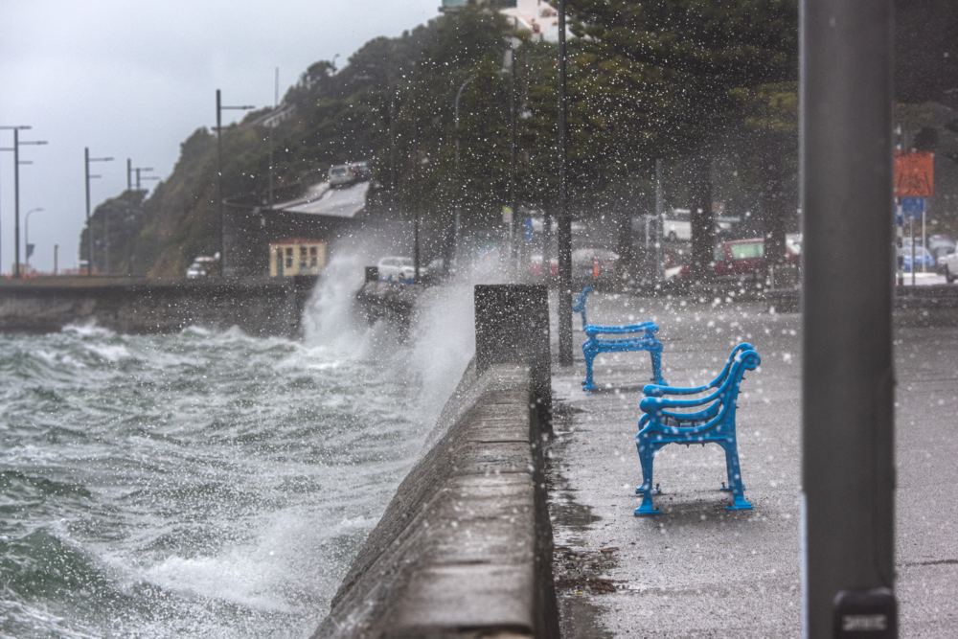
What is severe weather?
If you wake up and look out the window to see that it’s sunny, cloudy, rainy or a little bit windy, you probably won’t think too much about it.
However, once in a while the weather becomes much more dangerous – what meteorologists call severe weather.

Slide 3
Tropical cyclones
One of the most serious types of extreme weather to affect New Zealand are tropical cyclones. Cyclones require very warm ocean temperatures of 27°C or greater.
Tropical cyclones are also HUGE—the largest can measure up to 2,000 km in diameter with the strongest ones having wind gusts over 300 km/h!
Strong winds can easily destroy trees and buildings. However the most dangerous aspect of a tropical cyclone can be what’s called storm surge. Storm surge causes flooding in coastal areas as the cyclone reaches land.

Slide 4
Severe thunderstorms and tornadoes
Thunderstorms can form when the atmosphere is unstable, usually meaning that air near the ground is much warmer than air high in the atmosphere.
Here in New Zealand, thunderstorms must meet one or more of these specific criteria to be considered severe:
Heavy rain of 25 mm per hour, or more
Large hail of 20 mm diameter or more
Wind gusts of 110 km/h or more
Tornadoes with wind speeds of at least 116 km/h.

Slide 5
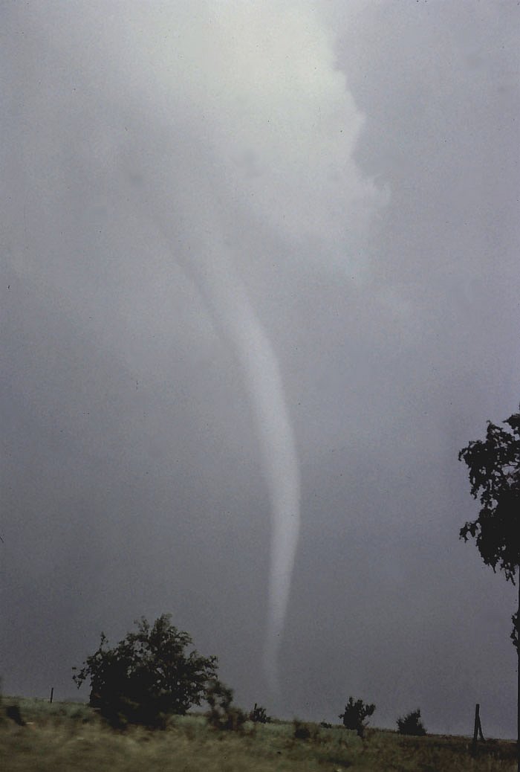
Tornadoes are violent rotating columns of air extending from severe thunderstorms to the ground or water. When they touchdown on water this is called a waterspout.
The strongest tornadoes are capable of producing incredible destruction with wind speeds of 450 km/h or more, and widths of up to 1.5 km!
Luckily, tornadoes in New Zealand are much rarer. The region most likely to see tornadoes is Taranaki, although they can occur anywhere in New Zealand.

Slide 6
Drought
A drought refers to a lack of rainfall that results in a water shortage for some activity, group, or industry.
Droughts can last for months or even years!
In fact, from late 2019 through the first half of 2020, rainfall in the Upper North Island and Auckland was well below normal, causing councils to enact water use restrictions.

Slide 7
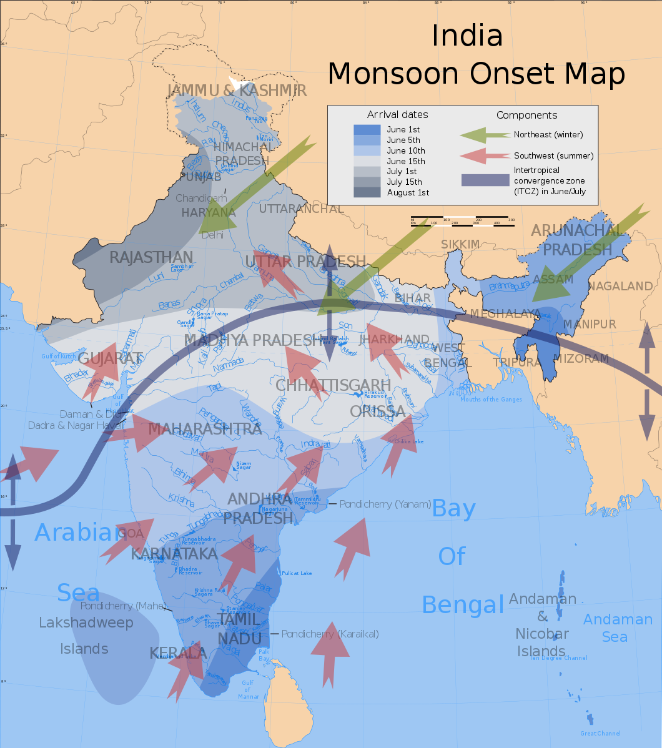
Monsoon
A monsoon is a large-scale reversal of wind direction that can result in weeks or even months of heavy rainfall.
While monsoons occur in several different parts of the world, the most well-known occurs in South Asia; particularly affecting India and Bangladesh.
The eastern Indian village of Mawsynram is considered the wettest place on earth, with an average annual rainfall of almost 12,000 mm!

Slide 8
Kahoot quiz: Severe weather
https://play.kahoot.it/v2/?quizId=c9219467-fe52-4f3a-8c68-7bf88e873277

