Slide 1

Weather forecasting
Rangi weather and climate curriculum

Slide 2
Weather forecasting
We can easily look out our window and see what the weather is like right now. But what if we need to know what the weather will be like in the future, say tomorrow or next week?
Maybe your family are planning to have a picnic next weekend, but you won’t be able to have it outside if it’s going to rain. How can your family plan ahead?
This is where meteorologists rely on lots of cool technology to predict the future.

Slide 3
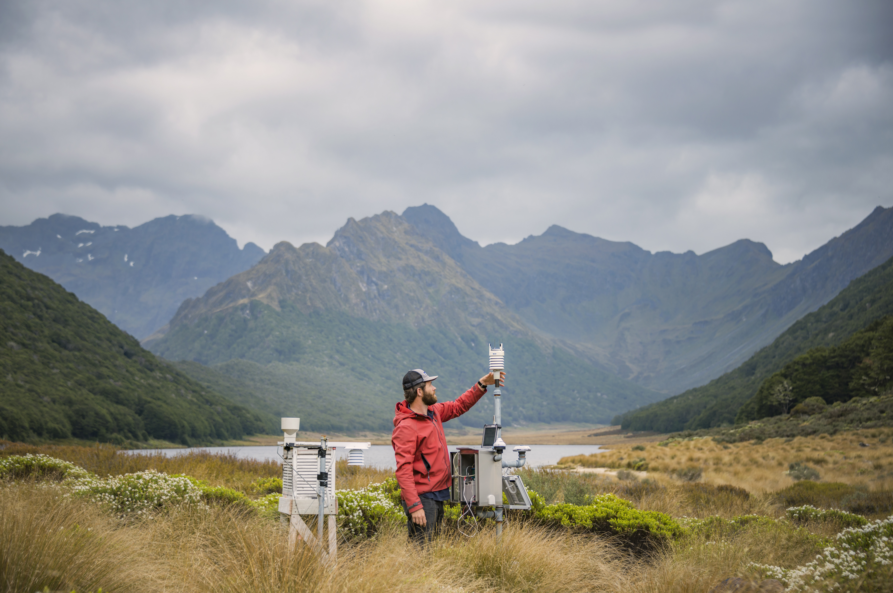
Weather stations
Forecasting future weather starts by knowing what the weather is doing right now – everywhere in the world!
Since we can’t be everywhere at once, we rely on weather observations that are recorded by weather stations all around the globe, usually at least once per hour, every hour, 365 days a year.
Even right here in New Zealand we have hundreds of weather stations taking weather observations every day.

Slide 4
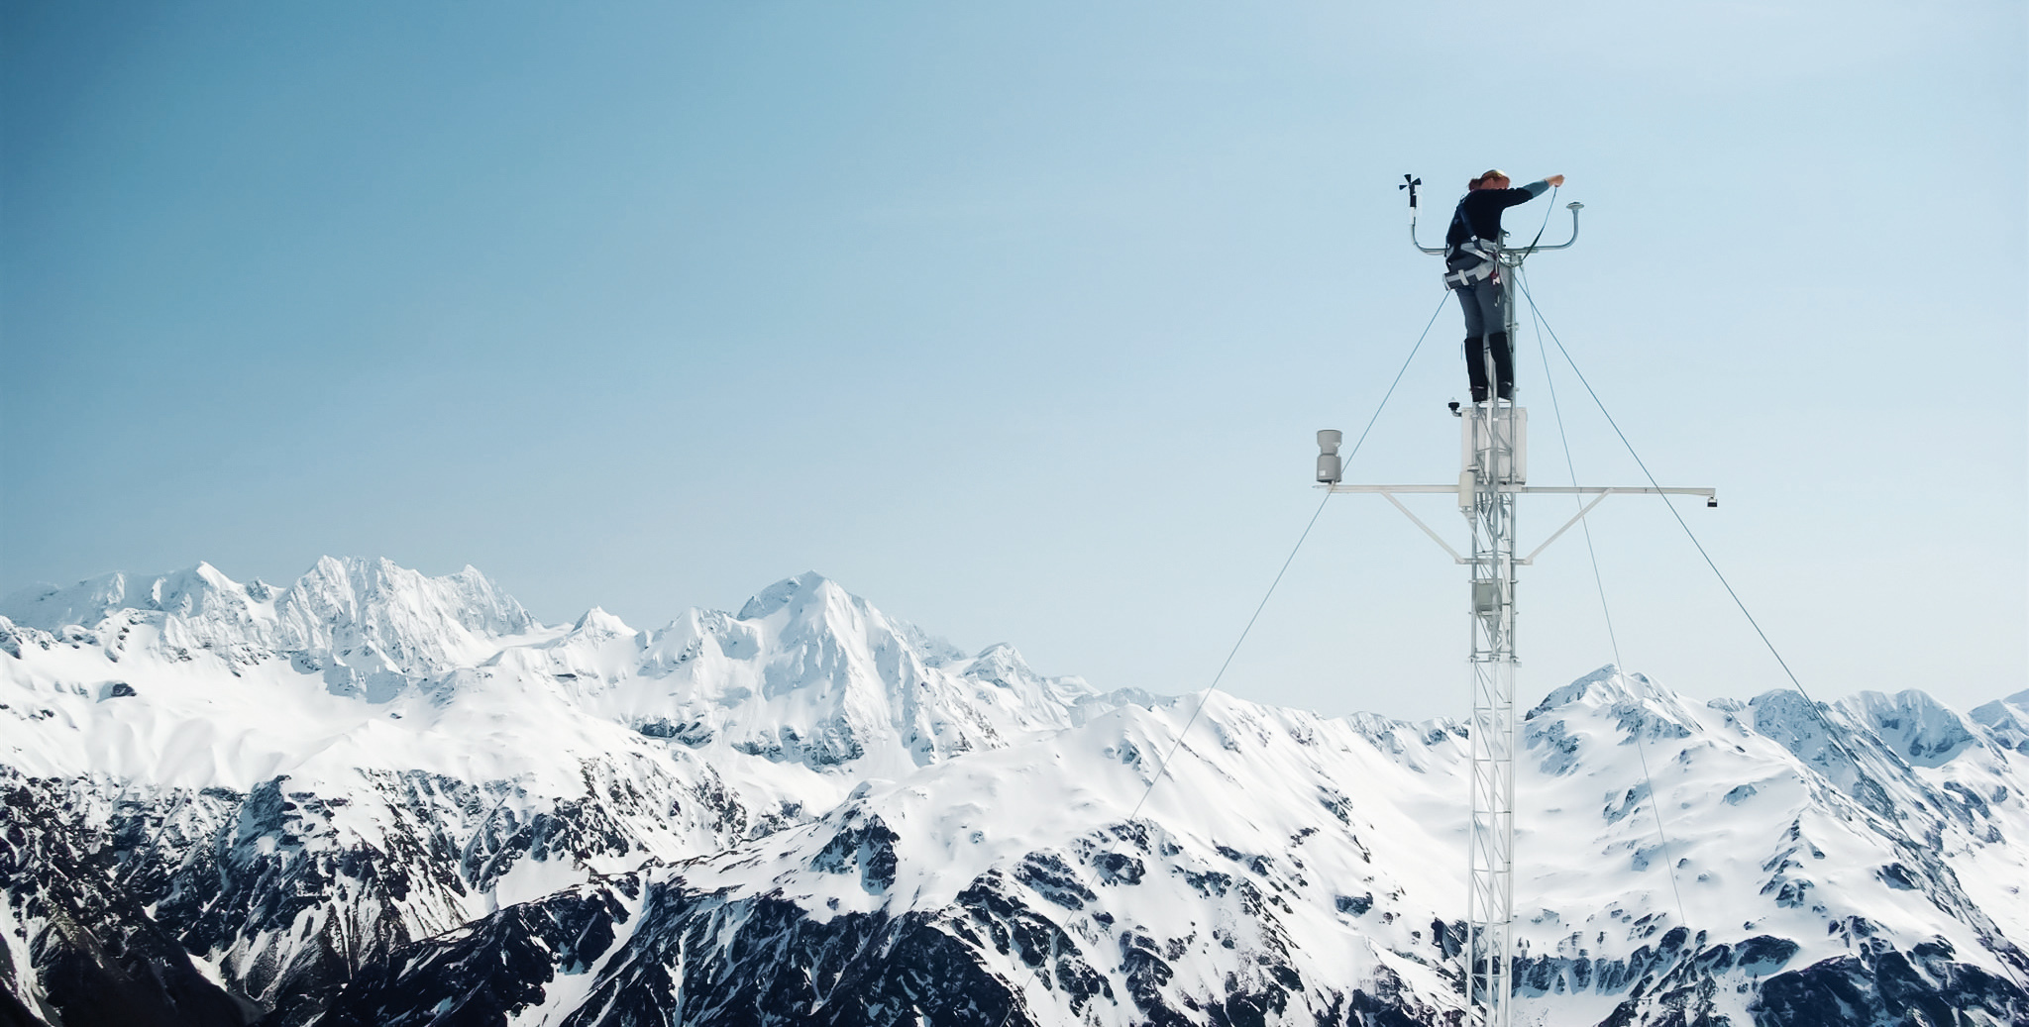
Weather station instruments
Thermometer: This tells us what the temperature is throughout the day.
Anemometer: This instrument usually sits on top of a giant pole about 10 metres above the ground and records the wind speed.
Rain gauge: This one’s pretty easy – it tells us how much rain has fallen today.
Barometer: A barometer can actually “feel” how much pressure is in the atmosphere and how quickly it’s going up or down.

Slide 5
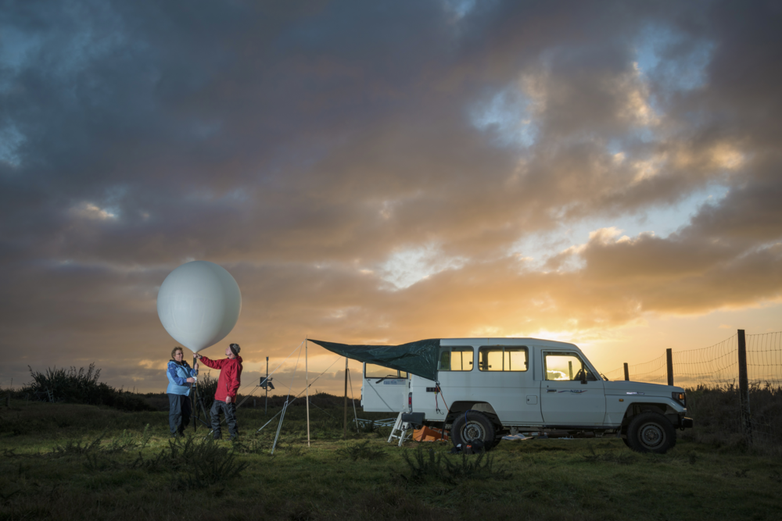
Weather balloons
It is also important to know what’s happening high in the atmosphere. Weather balloons are released from the ground and can fly higher than airplanes.
They have small instruments attached to them that record things like temperature, wind speed, and wind direction as they climb. This data is sent back to the ground using a simple radio.

Slide 6
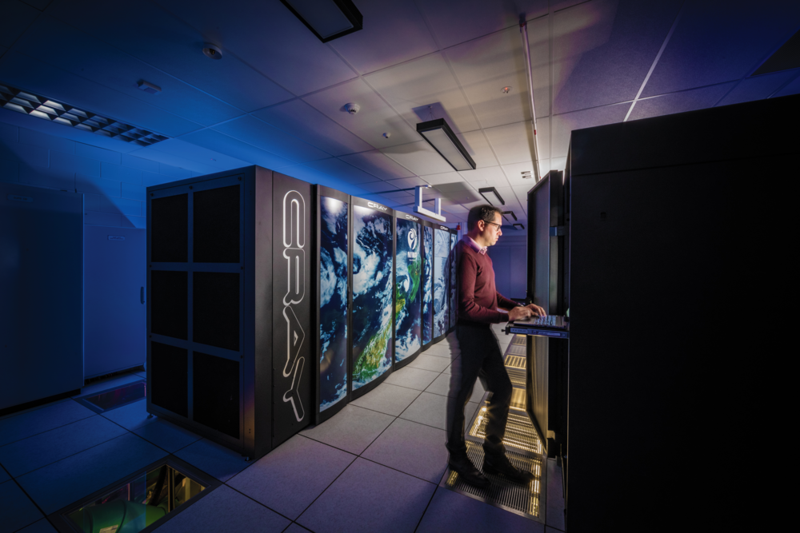
Supercomputers and meteorology
With so much weather data being collected every day, it’s impossible for humans to analyse it all and make a forecast within a reasonable amount of time.
So the data goes into powerful supercomputers that speed up the process. These supercomputers are as big as an entire room, and more powerful than 10,000 desktop computers.

Slide 7
Supercomputers and meteorology
The supercomputers run incredibly complex math equations that determine how the earth’s atmosphere moves, and we get the supercomputer’s best guess about what the weather will be like over the next several days.
At this point human meteorologists step in. While the forecast produced by the supercomputer is usually pretty good, the meteorologist has years of experience and can make the forecast even better.
Forecasts three to five days in the future are usually very accurate, and forecasts seven days out can still give a general idea of what’s to come.

Slide 8
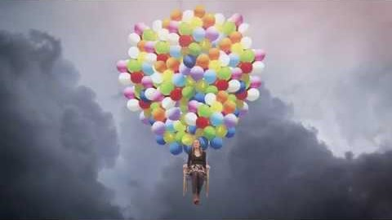
Video: Weather Tips from Weather Nerds - Weather Balloons
https://www.youtube.com/watch?v=qIf6KhmwfsU

Slide 9

Kahoot quiz: Weather forecasting
https://play.kahoot.it/v2/?quizId=a14c9fe6-a679-4f3e-97a7-9e6f2d4e4a54

