Slide 1

Wind
Rangi weather and climate curriculum

Slide 2
What is wind?
Wind is air in motion, both near the earth’s surface and high up in our atmosphere. Air is made of molecules, such as nitrogen and oxygen, and when these molecules move together in a direction, we get wind.
Wind can vary in strength from a gentle breeze pushing a leaf along a path to a strong gale that can cause severe damage. The most powerful wind happens during storms like tornadoes and tropical cyclones.

Slide 3
What makes wind blow?
Wind is caused by pressure gradient, or the difference between high and low pressure.
Think about high pressure like the top of a hill and low pressure as the bottom of the hill. If you roll a ball from the top it will quickly rush down to the bottom. The same thing is happening with wind.
The larger the pressure gradient is (the difference between the top and bottom of the hill), the stronger the wind will be.

Slide 4
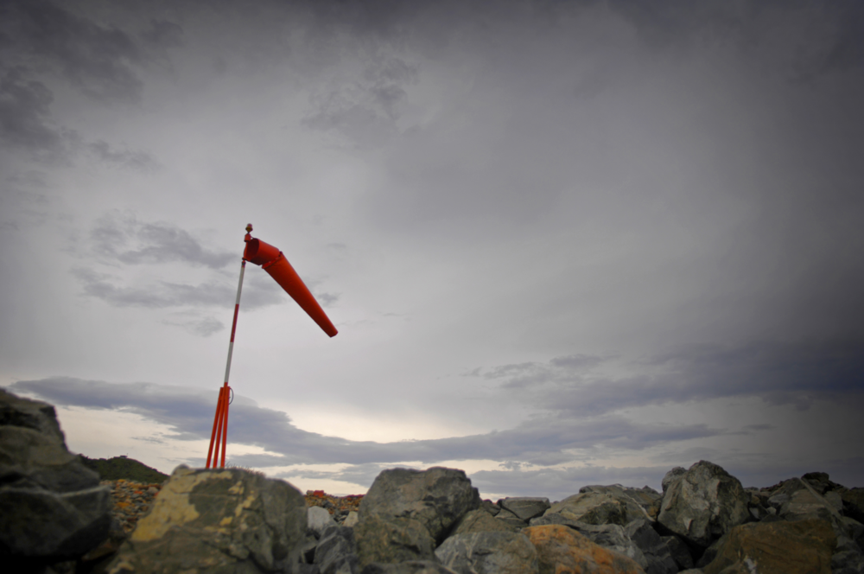
Wind direction
When you talk about wind direction it is described by where the wind is coming from. So if the wind is blowing from the west to east, we call it a westerly wind.

Slide 5
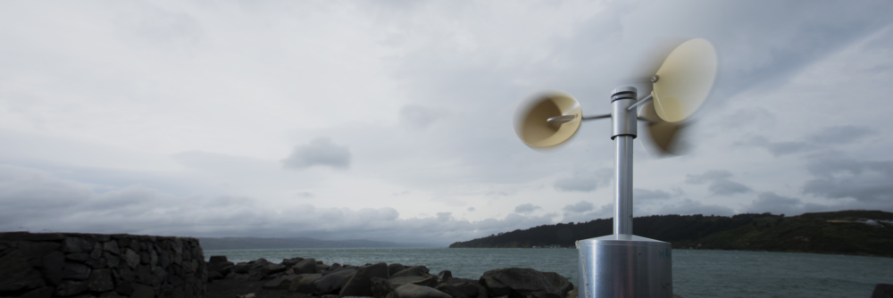
Wind speed
Wind speed is often measured in kilometres per hour (km/h) or metres per second (m/s) and scientists often use a tool called an anemometer to measure the speed.

Slide 6
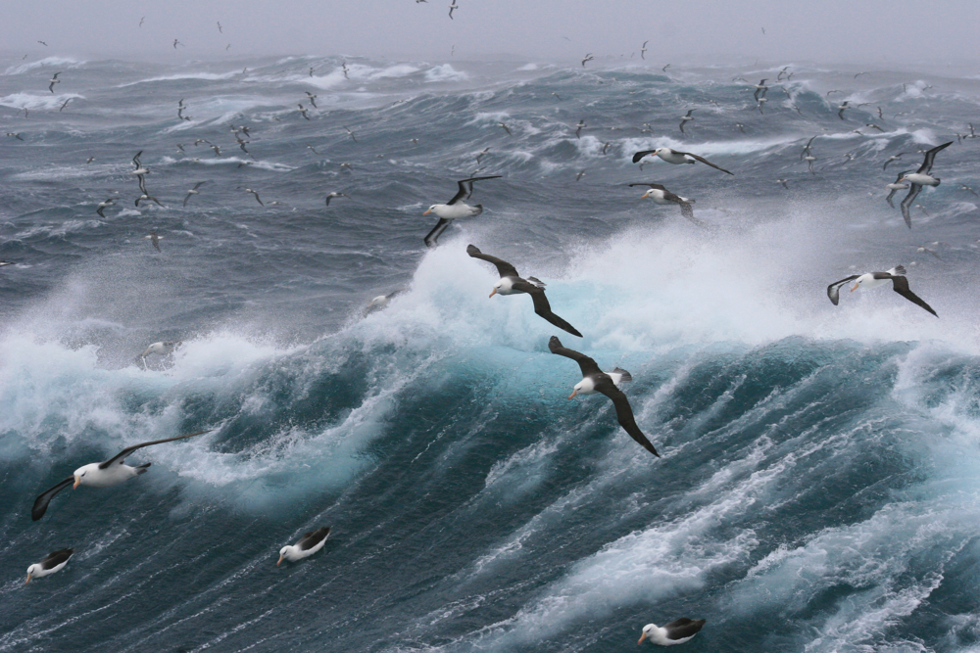
Wind gusts
A wind gust is a sudden increase in the wind’s speed that lasts no more than a few seconds.
On 10 April, 1996, Barrow Island in western Australia recorded a 407 km/h wind gust during Tropical Cyclone Olivia!

Slide 7
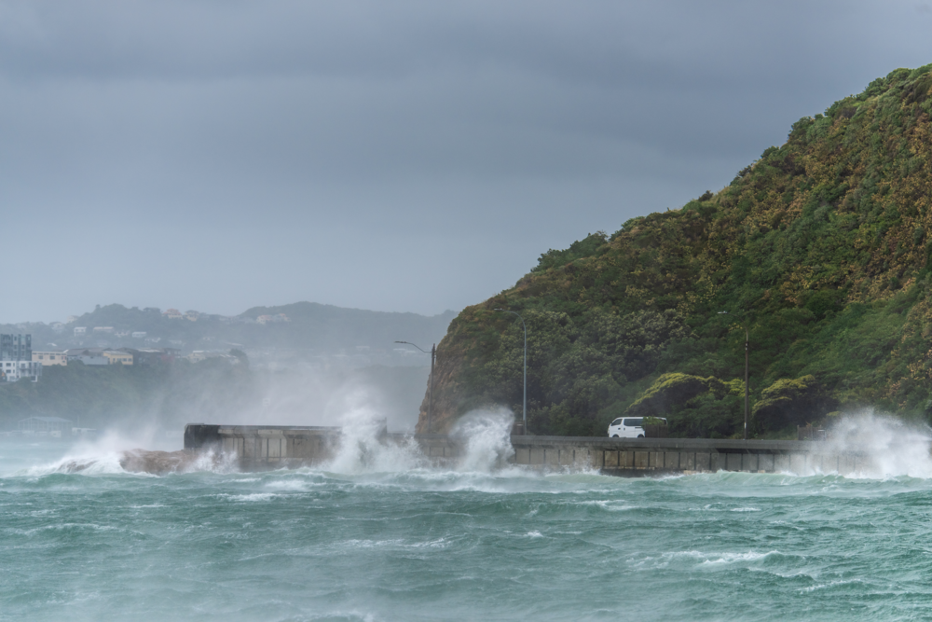
Windiest city on earth
Wellington!
The annual average wind speed in our capital is a whopping 29 km/h!

Slide 8
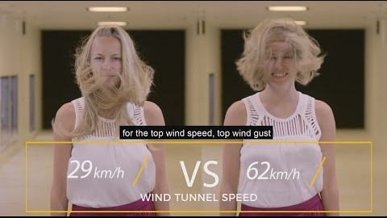
Video: Weather Tips from Weather Nerds - What causes wind?
https://www.youtube.com/watch?v=W4rKZKnRamY

Slide 9

Kahoot quiz: Wind
https://play.kahoot.it/v2/?quizId=d0e54f3c-6df6-4c88-a0b8-4a6b57474938

