Slide 1
Introduction to weather and meteorology
Rangi weather and climate curriculum

Slide 2
What is weather?
Officially, weather is defined as “the state of the atmosphere at a particular place and time”. But instead of learning a definition, it might be easier to think of the weather as what you see out your window every day. Is today sunny, cloudy, windy, rainy or stormy? All of those things are part of the weather.
Weather is what we see and feel in the short-term, meaning over the next few days or the next couple of weeks.

Slide 3
Clouds
Clouds are made up of billions of tiny water droplets. All air holds water, but near the ground it’s usually in the form of an invisible gas called water vapour. Air forms tiny droplets as it rises in the atmosphere.
When billions of these droplets come together you have a cloud!

Slide 4
Clouds
Cirrus clouds: These clouds are so high and so cold that they’re made of ice crystals instead of water droplets! They look thin and wispy as strong winds high in the sky blow them into long streams.
Cumulus clouds: These clouds are fluffy and white and look like cotton balls floating in the sky. Cumulus clouds often form only around 1,000 metres above the ground.

Slide 5
Clouds
Cumulonimbus clouds: Tall, ominous-looking clouds that can become thunderstorms. Expect heavy rain, lightning, hail, and maybe even tornadoes when you see these clouds.
Stratus clouds: Flat, grey clouds that cover the whole sky. These clouds usually produce drizzle or light rain.
Fog: Fog is just a regular cloud that forms down at ground level. Fog typically forms when warm air blows over much colder soil or even snow.

Slide 6
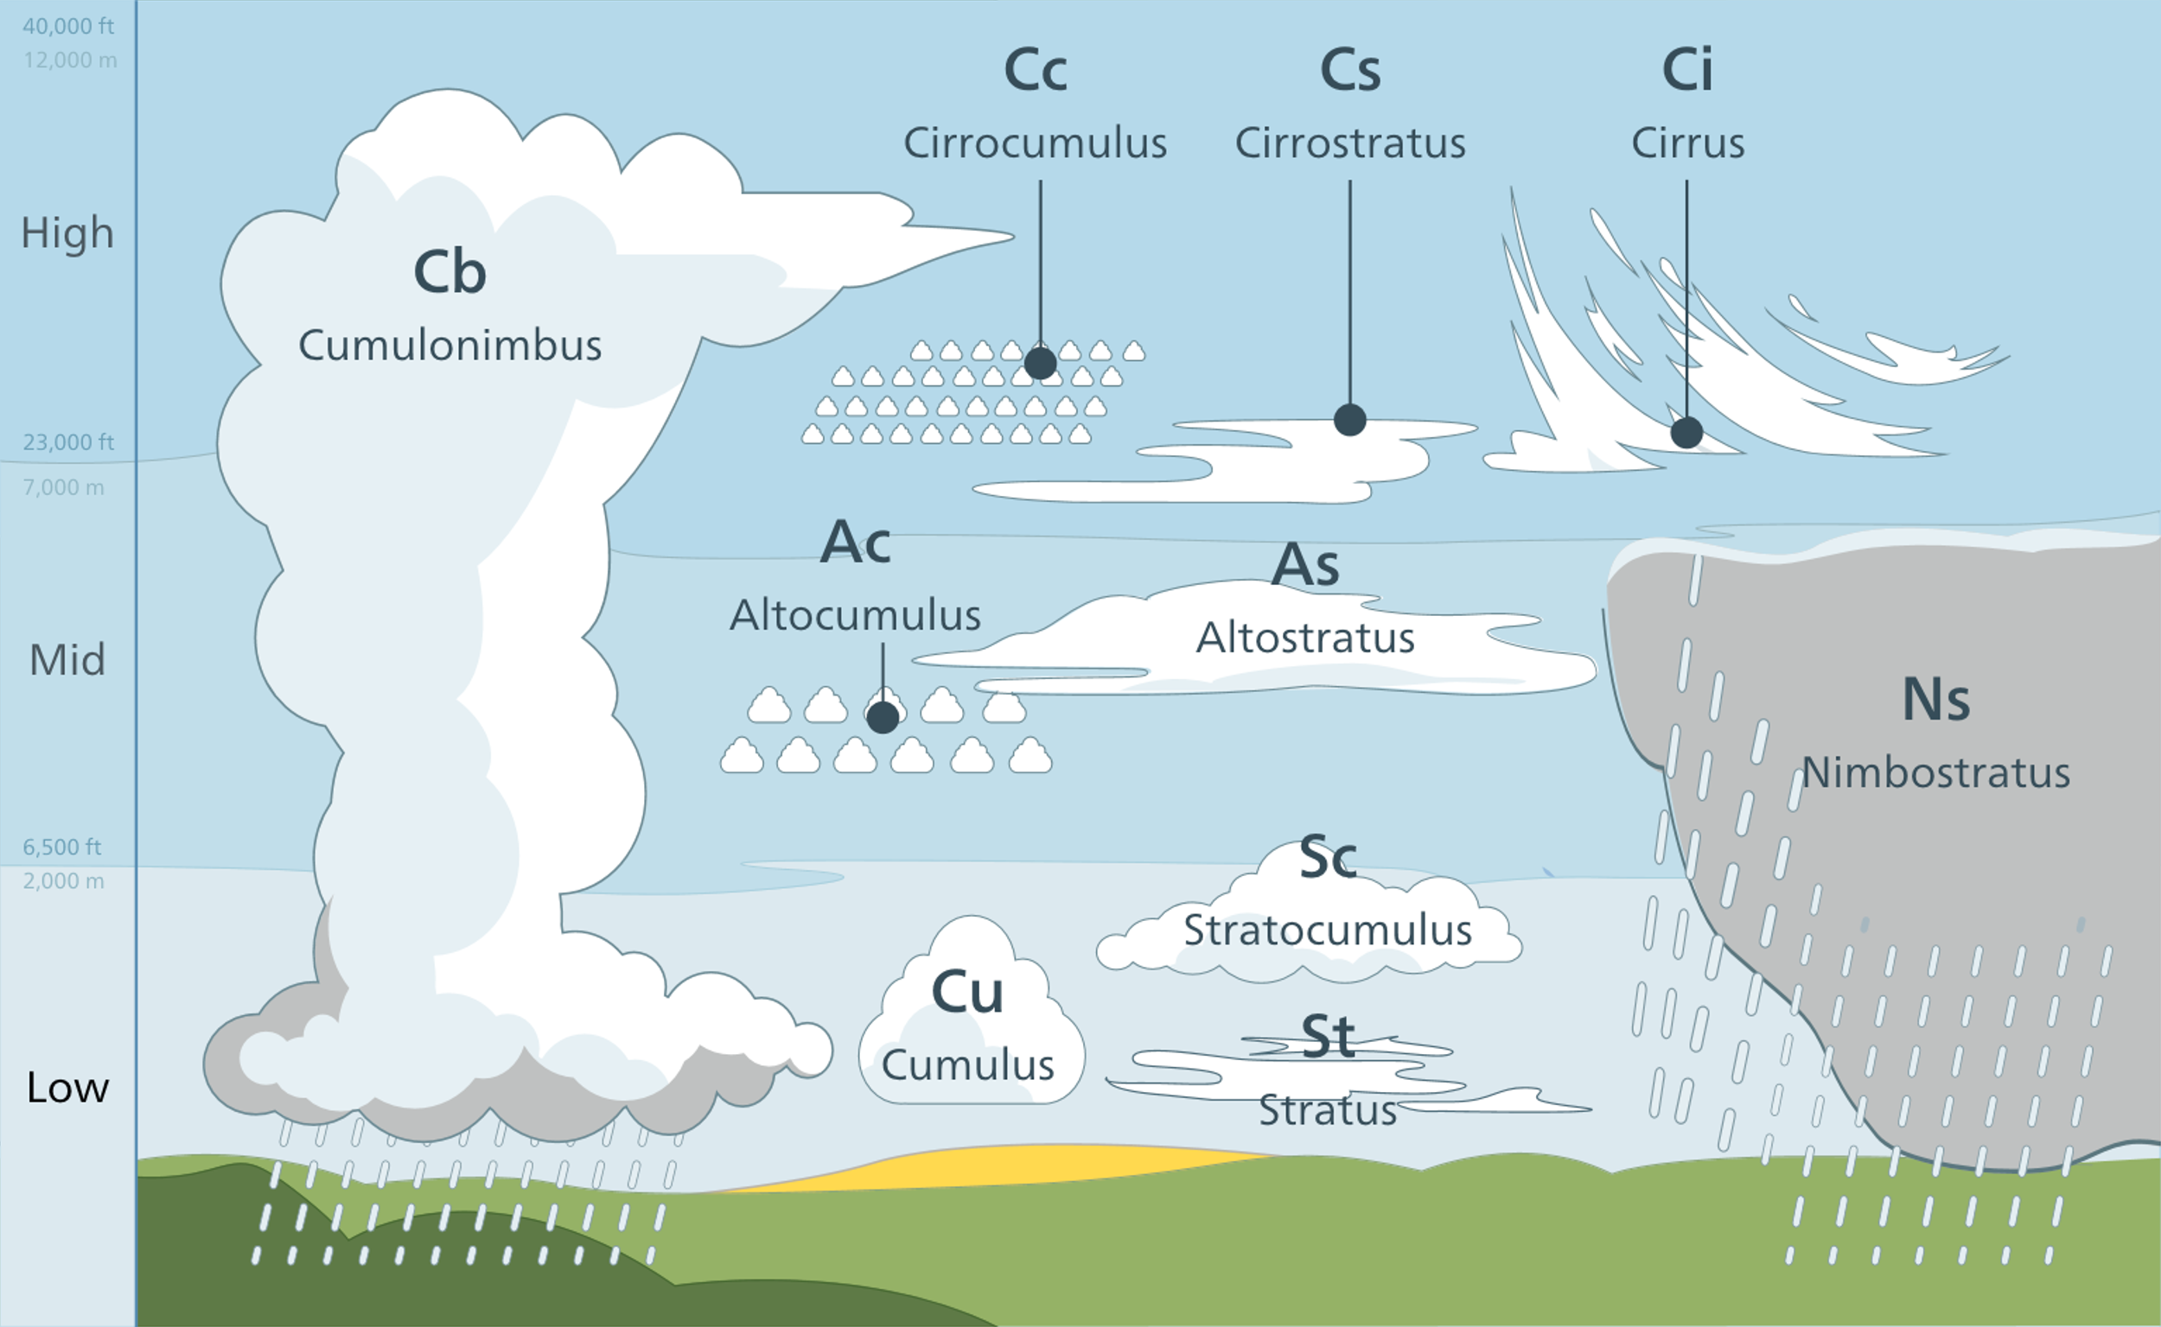

Slide 7
Low and high pressure
Areas with low pressure are usually associated with bad weather.
Areas with high pressure are usually associated with good weather.

Slide 8
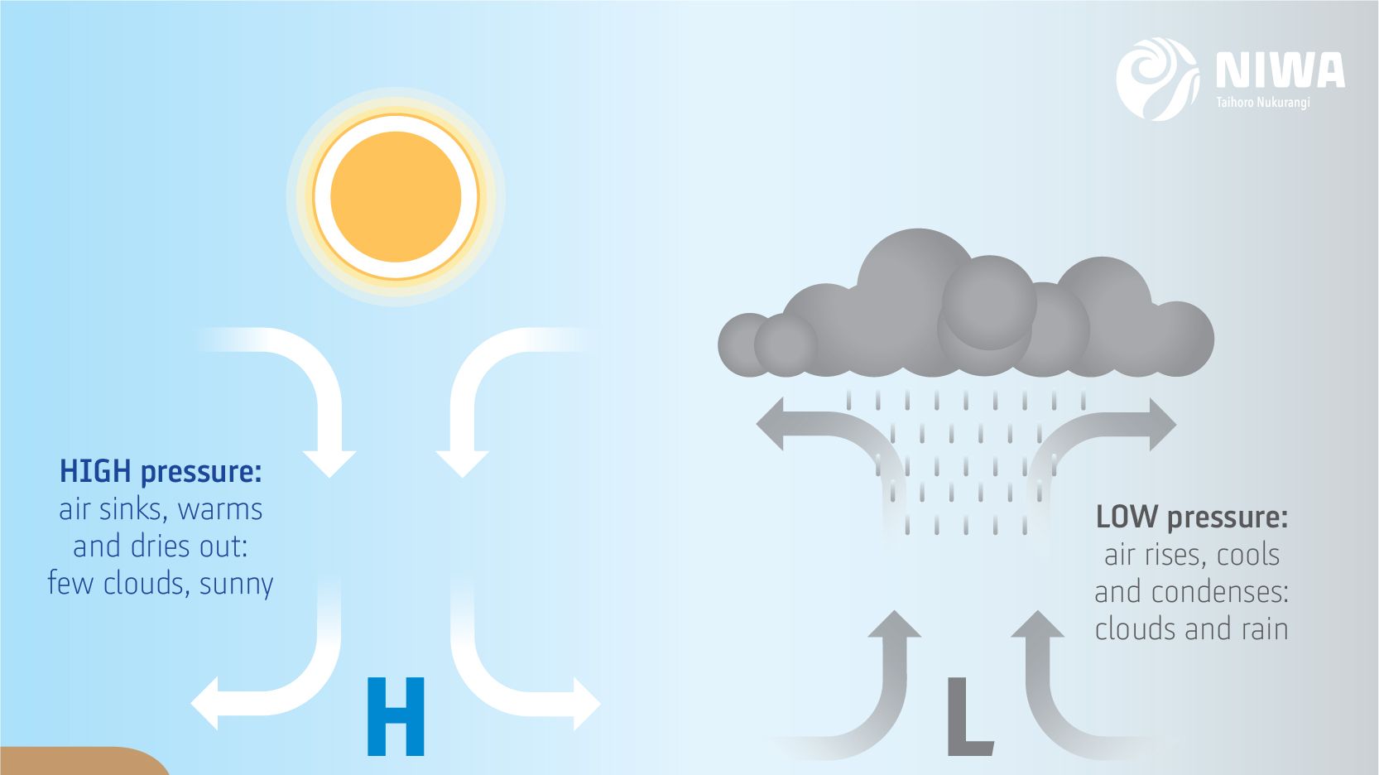

Slide 9
Warm and cold fronts
A front is a boundary between two different air masses (usually one warm and one cold), and along fronts there is often stormy weather, sharp temperature changes, and rapid shifts in wind direction.
A cold front divides warm air and cool air, moving so that the cooler air replaces the warmer air. A warm front works in the opposite way, with warmer air replacing the cooler air.

Slide 10
Video: Weather Tips from Weather Nerds - What is a meteorologist?
https://www.youtube.com/watch?v=zAwizy_OORc

Slide 11
Kahoot quiz: Introduction to weather and meteorology
https://play.kahoot.it/v2/?quizId=41660e36-f681-4bc0-82a3-f31b2b24b6de

