Slide 1

Becoming a climate solver
Rangi weather and climate curriculum

Slide 2
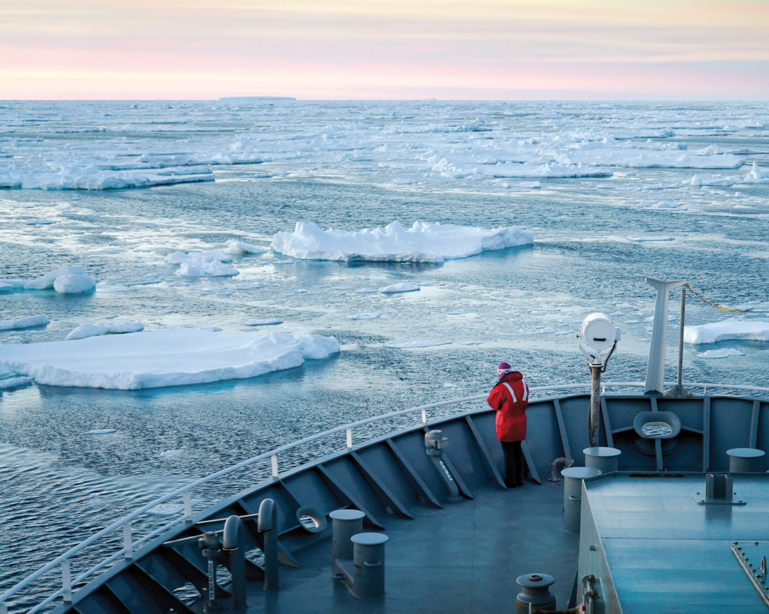
Understanding our choices will help us adapt to a changing climate
Climate change is already affecting communities and livelihoods in New Zealand through increased temperatures, longer droughts and more intense storms.
Understanding what is important to everyone helps us make choices about how to adapt to our changing climate in ways that suit the needs of our communities.

Slide 3
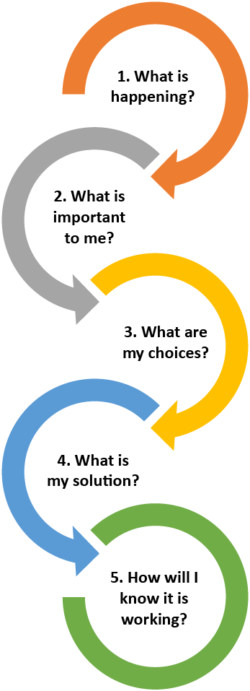
Pathways thinking
Pathways thinking is a framework being used throughout New Zealand and the world by businesses, communities and governments to guide their thinking about how we adapt to the challenges of climate change.
This framework will allow your class to work through the same process and to become empowered by the knowledge that by planning and making changes we can live well in a changing world.

Slide 4
Pathways thinking example
1. What is happening?
What could happen at my place and in my community?
How vulnerable could I be to this?
Some days are already hot in our school playground – we burn our feet on the concrete and need to drink lots of water! And it’s likely to get even hotter in the future.

Slide 5
Pathways thinking example
2. What is important to me?
What could be affected by climate change that I value or need?
How important are these to my whānau and community?
We love playing outside and want to be able to continue to do so, even on the hottest days. My whānau – especially my little sister and cousins, also like using the playground on the weekends.

Slide 6
Pathways thinking example
3. What are my choices?
How can I adapt?
What are the potential solutions I can choose from?
There are lots of things we could do – move the playground into the shade, put up a shade sail, put in a drinking fountain, change the concrete surface to something that doesn’t get as hot, play inside on hot days.

Slide 7
Pathways thinking example
4. What is my solution?
What can I do now?
What can I do later?
What can I do much later?
The school could fundraise for a shade sail, new drinking fountain and plant trees to make the area cooler now. And we could plan that when the playground needs upgrading in the future we choose materials that don’t get as hot in the sun and that we maximise the shade available.

Slide 8
Pathways thinking example
5. How will I know it is working?
What changes should I look for to know my plan is working?
We’ll know it’s working if we can keep playing outside safely!

Slide 9
Activity – understanding what’s important to us all
This activity is a whole-class discussion support tool, to help students identify common themes in environmental stewardship and share those values with their classmates. Students identify and prioritise what they want to protect or change in their community where the climate is changing.
The next slides show statements of values. The class can record their comments digitally to indicate the 3 choices that are most important to them and why.
Alternatively, A4 pages of the statements can be downloaded from the Rangi webpage and printed.
You’ll likely come up with some questions that are more appropriate to your region/area, for example if you’re in a coastal location, so feel free to add or remove as needed.

Slide 10

I use reusables, e.g. straws, cups

Slide 11

I know which bins to put the recycling into

Slide 12

I want to be able to swim in the river or sea

Slide 13

I know how to tell if it is safe to swim in the river

Slide 14

I want to be able to walk along the beach

Slide 15
We collect rainwater at my house/school/marae

Slide 16

I want to plant trees to make a habitat for wildlife

Slide 17

I want to see lots of fish and insects in our streams

Slide 18

I want to be able to go fishing and collect shellfish

Slide 19
What next?
The ideas and discussions around this activity could be used to form a plan for future environmental activities the class or school could undertake.
Some ideas include:
Fundraising for something to improve your school environment.
Planting some trees (you might be able to join with an organisation like Trees for survival).
Joining a beach clean-up or river restoration project (organisations like Sustainable Coastlines can help, or you can plan your own).
Checking out a list of activities from the Department of Conservation.
Finding out about becoming an Enviroschool.

