Slide 1

Glaciers
Rangi weather and climate curriculum

Slide 2
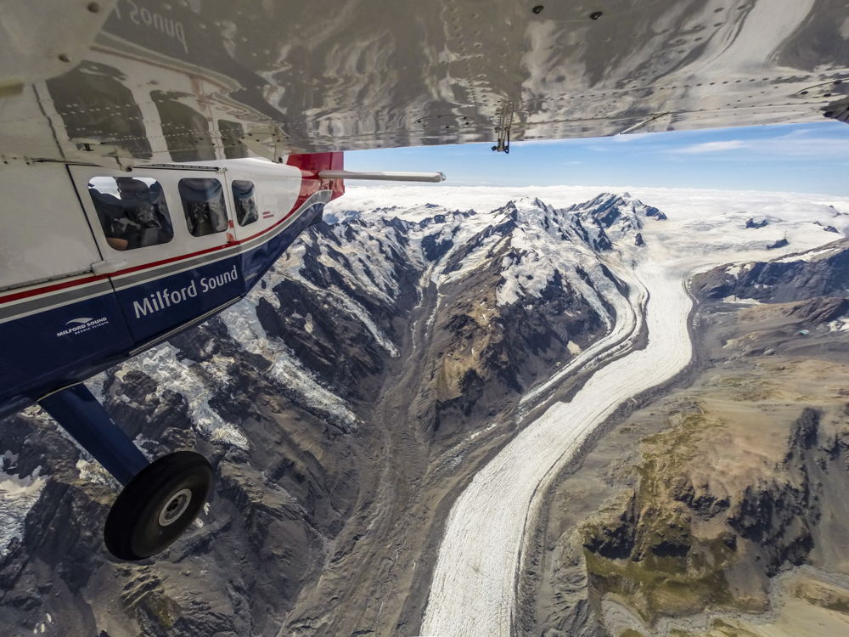
What is a glacier?
Glaciers are found in cold regions across Earth from the high mountains to the poles. They are beautiful to see and are a majestic, pristine part of our natural landscape.
A glacier is a huge mass of ice that moves slowly over land. They are formed when lots of snow that builds up year after year in the same location turns into ice. It can take hundreds and even thousands of years for a glacier to grow!

Slide 3
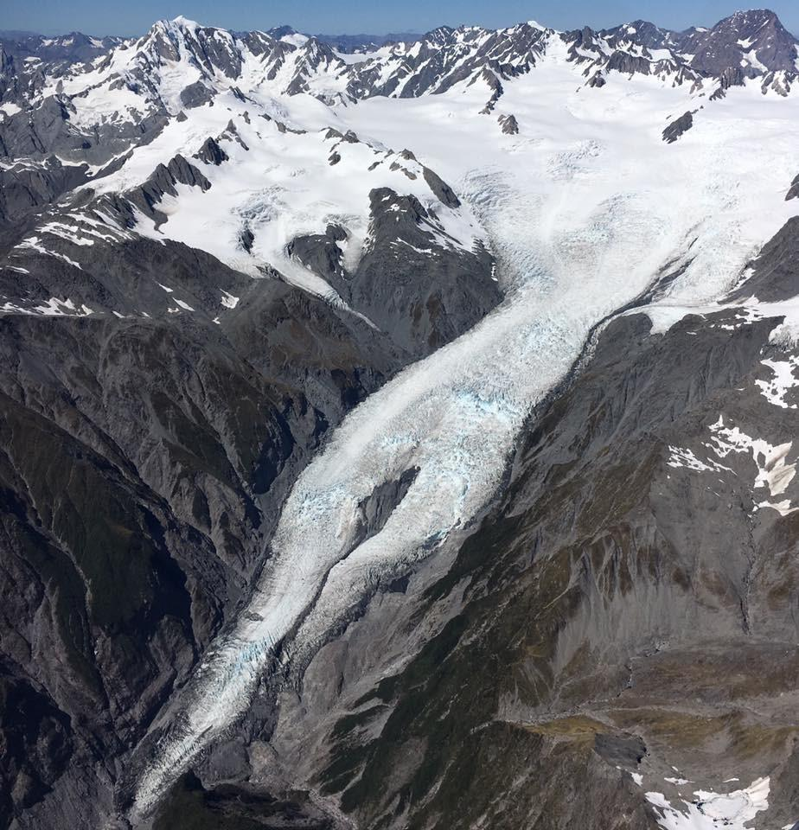
Glaciers can start to grow in places where snowfall is preserved from year to year over long periods of time.
Glacier ice contains mostly water, air bubbles and small amounts of dust and debris. Glacier ice has a lower density than water, which is why icebergs from glaciers float in water!
This picture shows the Franz Josef Glacier in the South Island of NZ.

Slide 4
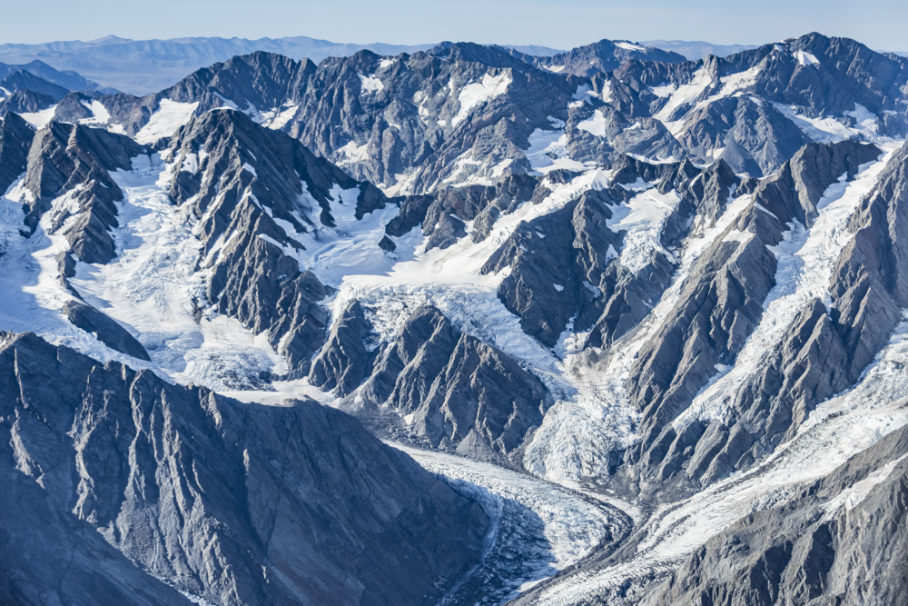
Where are glaciers found and why?
Alpine glaciers
Alpine glaciers form on mountainsides and move down through valleys. In New Zealand, alpine glaciers form in and around the Southern Alps. Our highest volcanic peaks on the North Island also have small glaciers.
Glaciers form here because the mountain tops stick high up into sky where it is so cold the snow doesn’t melt and is able to turn into ice.

Slide 5
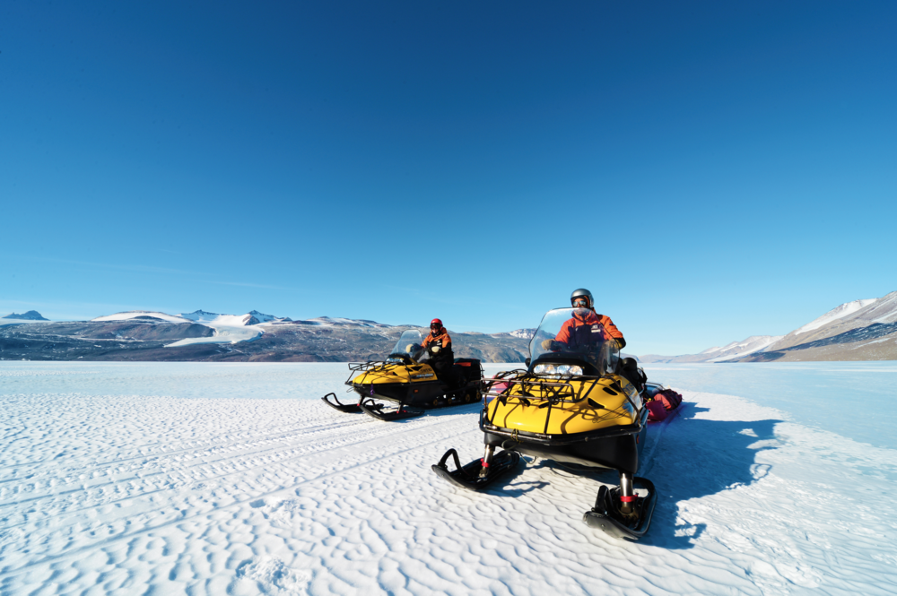
Where are glaciers found and why?
Continental ice sheets
Continental ice sheets form and spread out over large areas of land. Polar environments where continental ice sheets form, like Antarctica, are cold enough for glaciers to form because they are furthest away from the equator meaning they get less direct sunlight than any other places on Earth.

Slide 6
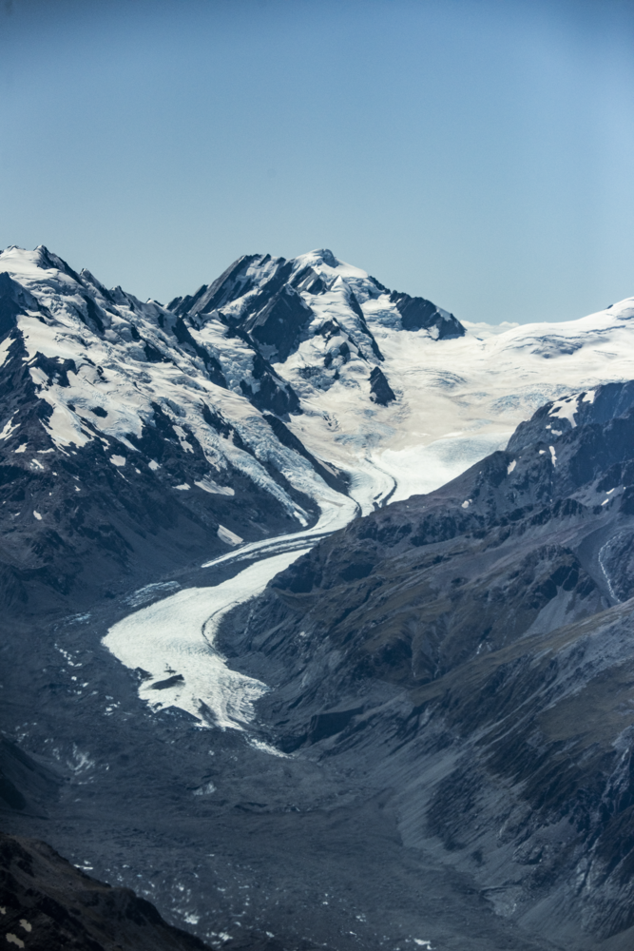
How do glaciers move?
A glacier may just look like a huge block of ice sitting still, but they are in fact moving. The weight of the ice, along with gravity, cause the glacier to move very slowly downhill, like a slow-flowing river.
The huge weight of the glacier causes ice at the bottom to change shape and begin to flow, moving the glacier along. Sometimes water running under the bottom of the glacier can help it to move along too.

Slide 7
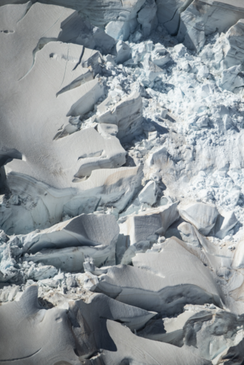
Why do we study glaciers?
Glaciers are important indicators of climate change because they are very sensitive to changes in temperature and precipitation (rain and snow).
They can tell us a lot about how the environment is changing and can help us explore what the impacts of changing temperatures are for times and places where we don’t have a lot of data.
We can also study glaciers to find out what the climate was like in the past, hundreds and even thousands of years ago.

Slide 8
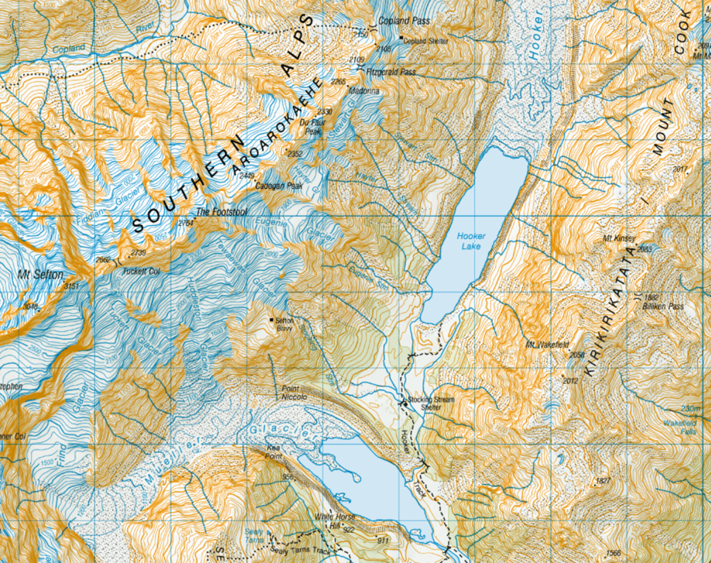
What tools do scientists use to study glaciers?
Photographs taken from planes
Maps
Snow markers which show how much the glacier moves over time
Thermal images
Did you know that the first NZ glacier inventory in 1978 counted 3144 individual glaciers?!

Slide 9
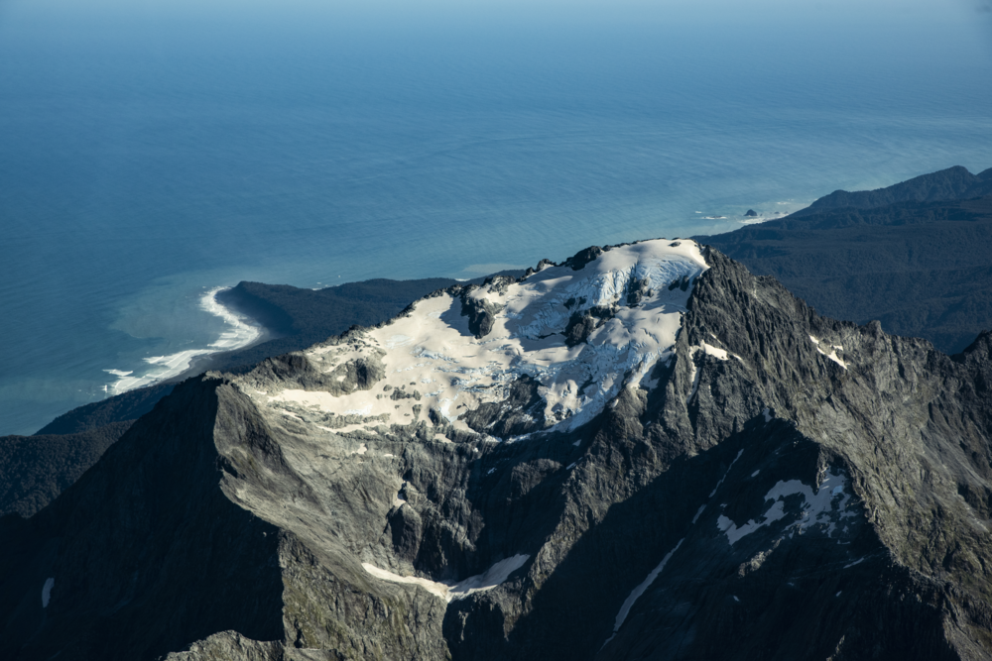
What is the impact of climate change on glaciers?
Warming temperatures are causing glaciers to melt faster than they can build up snow and continue to grow. If temperatures continue to rise, glaciers will continue to melt, and some could disappear completely.
We can already see the impact of climate change on the glaciers in New Zealand with many already beginning to melt and get smaller. Glaciers in the Southern Alps are have lost more than 30% of their ice volume over the last 40 years.

Slide 10
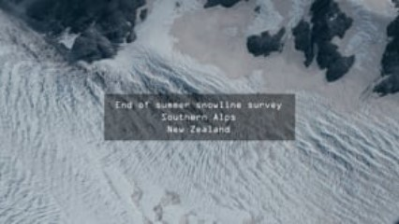
Watch this video about New Zealand’s glaciers and the work scientists do to measure them
https://vimeo.com/405686001

Slide 11

Kahoot quiz: Glaciers
https://play.kahoot.it/v2/?quizId=9b554b1d-eb85-4145-8f1e-63ed47758b2a

