Slide 1
Computing the climate
Rangi weather and climate curriculum

Slide 2
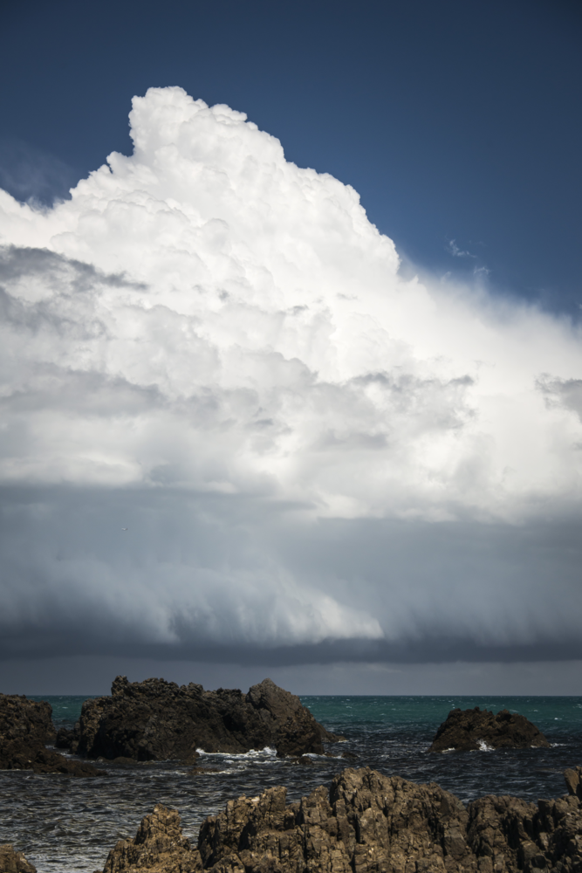
What is climate modelling?
We can explore how the world may change due to climate change by creating climate models.
By plugging lots of complex equations into a computer, scientists can build models of the what the climate may look like years into the future.
You can think of a climate model like a computer game and each time you play the game, you are generating a new simulation.
Put another way, simulations are the results of models!

Slide 3
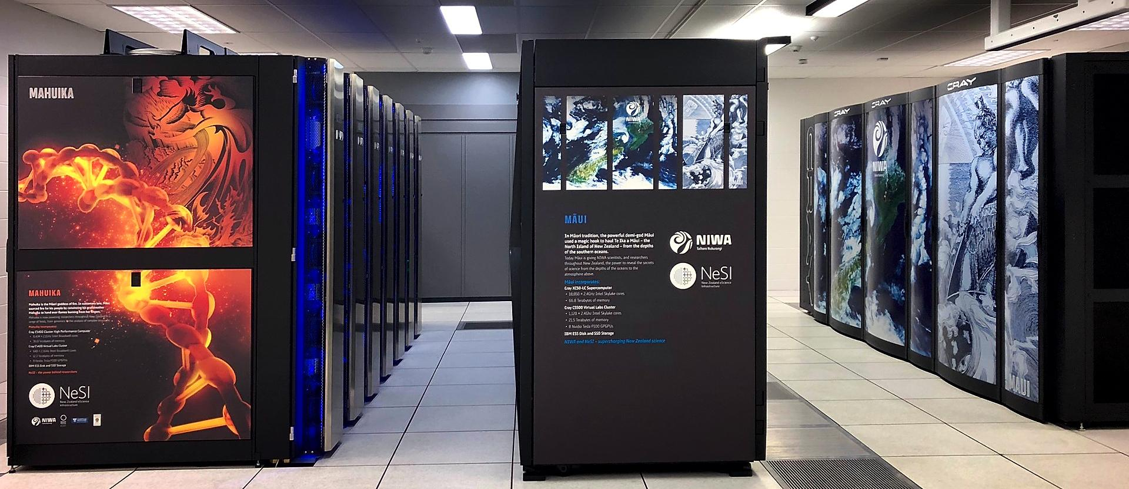
Supercomputers
We use powerful computers called supercomputers to create climate models.
These computers are not really that different to the ones that you might have at home or school. The main difference is they’re just a lot bigger and can do calculations a lot faster.
Here’s a picture of one of NIWA’s supercomputers. It’s called Māui.

Slide 4
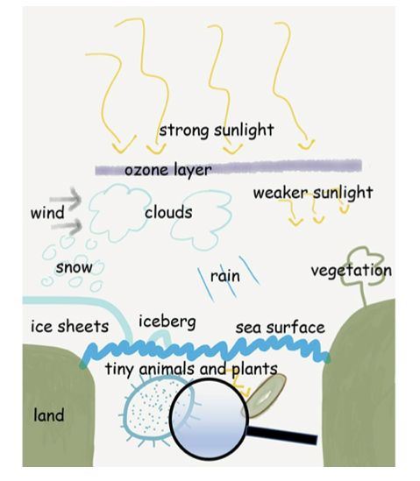
How do we create a climate model?
Because we are interested in many aspects of the climate, not just the air, we include many different natural processes in our computer models. Climate models use equations to represent how all of these different aspects interact together to drive the Earth’s climate. Some of these processes are shown in this picture:
Illustration credit: Jonny Williams, NIWA

Slide 5
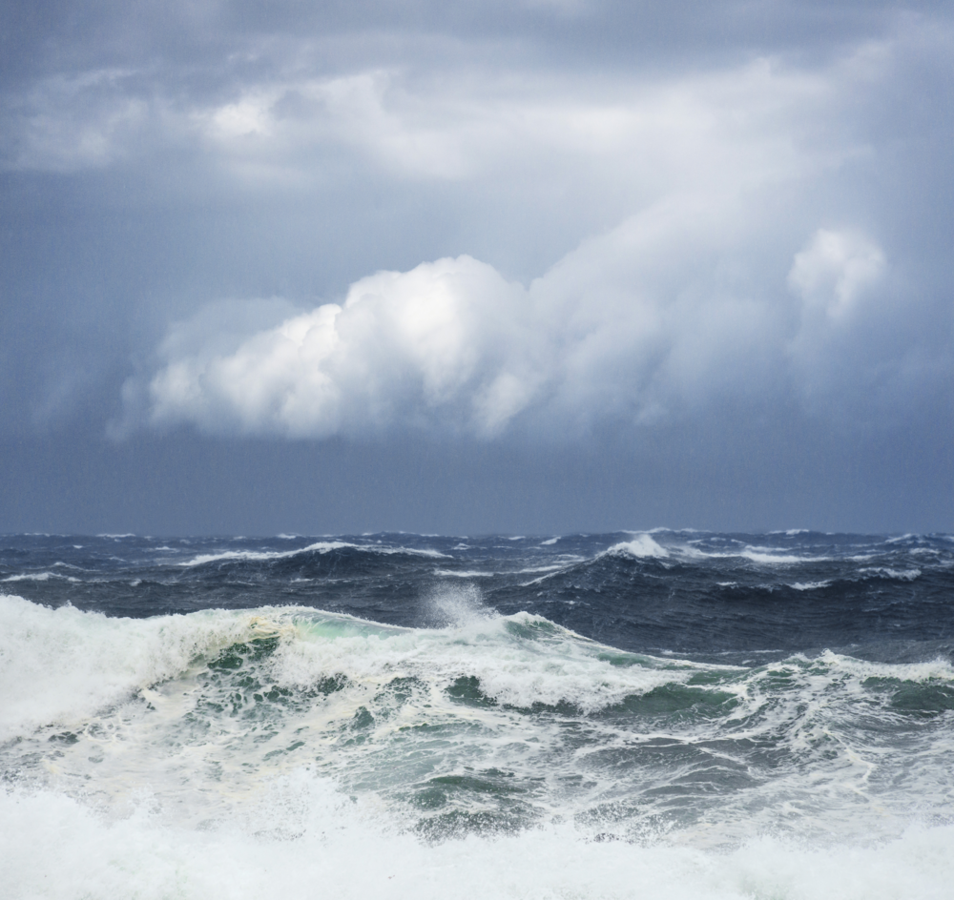
When we create a climate models, we include all of these processes in our calculations so that we can get an idea of how they may change in the future and how the climate may change overall. We can also get an idea of how these processes affect each other.
These models allow us to test different scenarios – like warmer atmospheric temperatures or more acidic oceans – to see what impact these changes may have on the climate and the natural world.

Slide 6
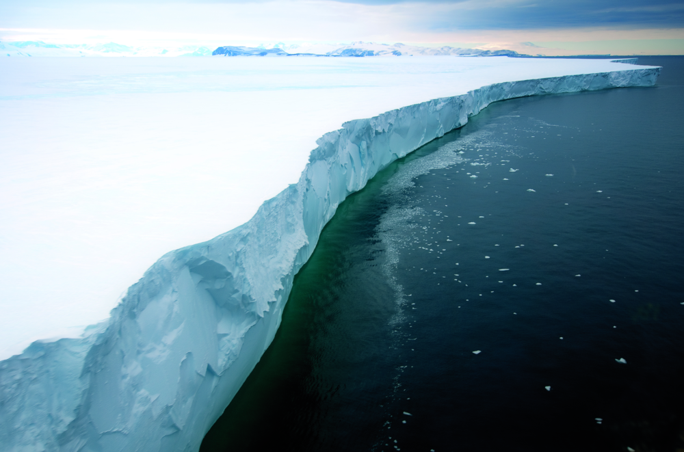
For example, increasing air temperatures over the South Pole may cause the ice on land there (called an ice sheet) to melt, changing the habitats of the fish, birds and mammals that live there.

Slide 7
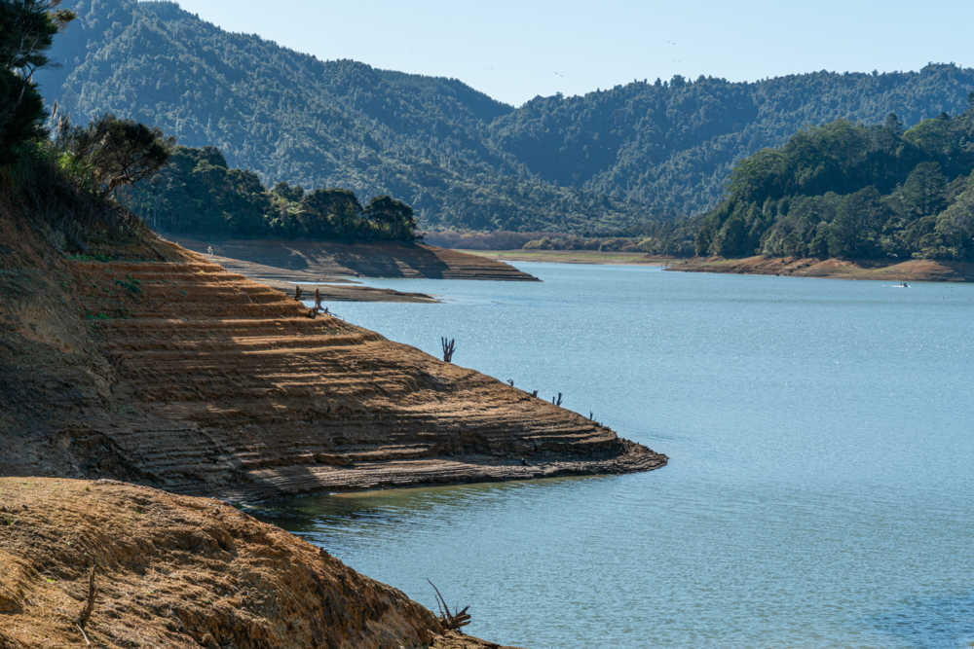
Climate models also allow us to test “What if?” scenarios and plan for the future. For example, if we predict it will rain less in a particular area, then that area may not be suitable for growing crops. Or if we predict that sea-levels will rise significantly, towns and houses near the ocean will be at risk and may have to be moved.

Slide 8
Kahoot quiz: Computing the climate
https://play.kahoot.it/v2/?quizId=16e4c573-898d-42d3-8014-c877d415f210

