Slide 1
Understanding past climate can help predict the future
Rangi weather and climate curriculum

Slide 2
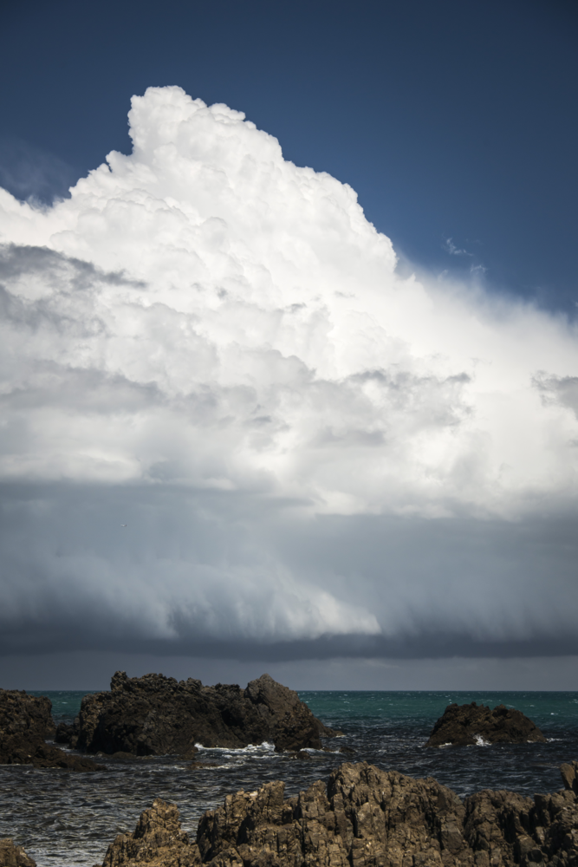
Why is it important to monitor our changing climate?
The earth’s climate has been changing naturally for billions of years.
But at the beginning of the Industrial Revolution in the 18th century, humans started to release large amounts of greenhouse gases into the atmosphere, causing the earth’s climate to warm and change.
This has greatly accelerated natural atmospheric processes (not caused by human activities) that cause the climate to change.
Ongoing monitoring of the climate is essential – we need to have good, accurate scientific observations to best understand climate change and prepare for the future.

Slide 3
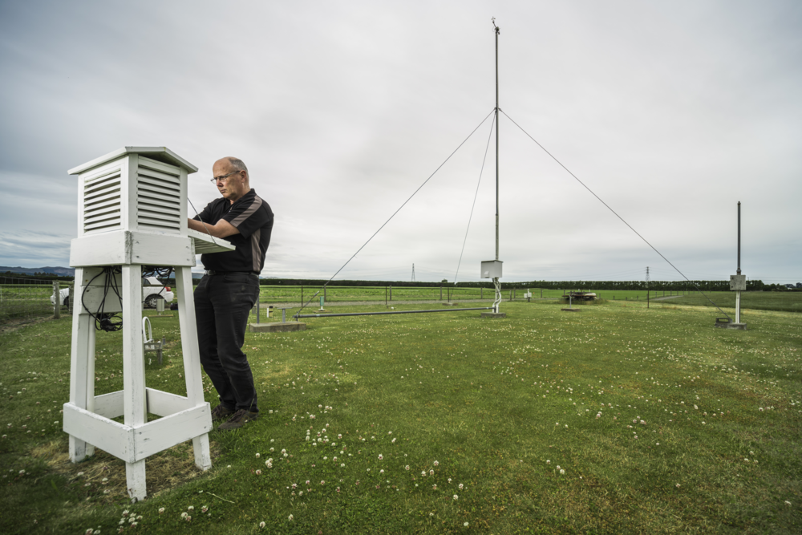
Tools to monitor climate: seven-station temperature series
In New Zealand, NIWA’s seven-station temperature series helps us understand how our national average temperatures have changed over a long period of time.
These climate stations, in seven locations around the country, collect important data which helps us understand temperature trends.
The stations are in Auckland, Wellington, Masterton, Nelson, Hokitika, Lincoln, and Dunedin, and have been operating since 1909.

Slide 4
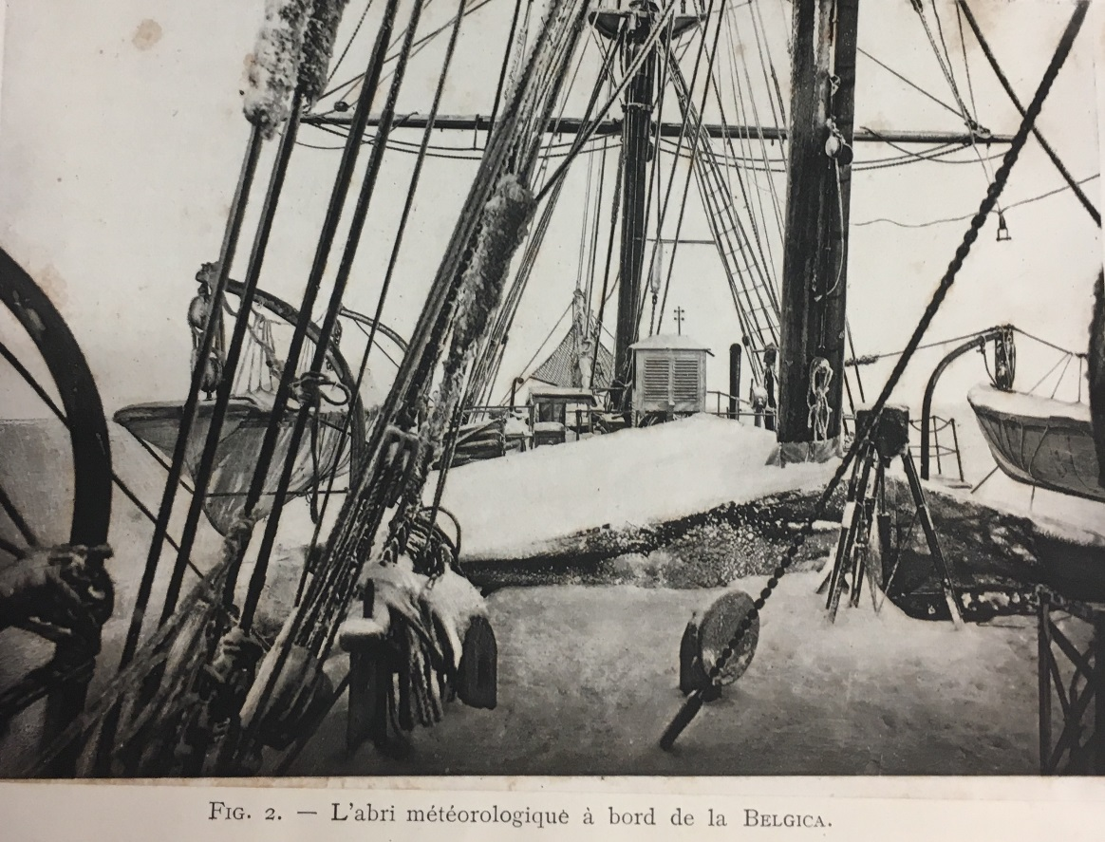
Tools to monitor climate: written and oral records
Written and oral records made by humans in the past can also be used to understand past climates.
For example, in the past, sailors at sea all over the world kept detailed logbooks of atmospheric conditions to help them with navigation and to understand what weather conditions might be coming over the next few days – there were no weather forecasts in those days.
Can you see the weather station in this old photo of a sailing ship?

Slide 5
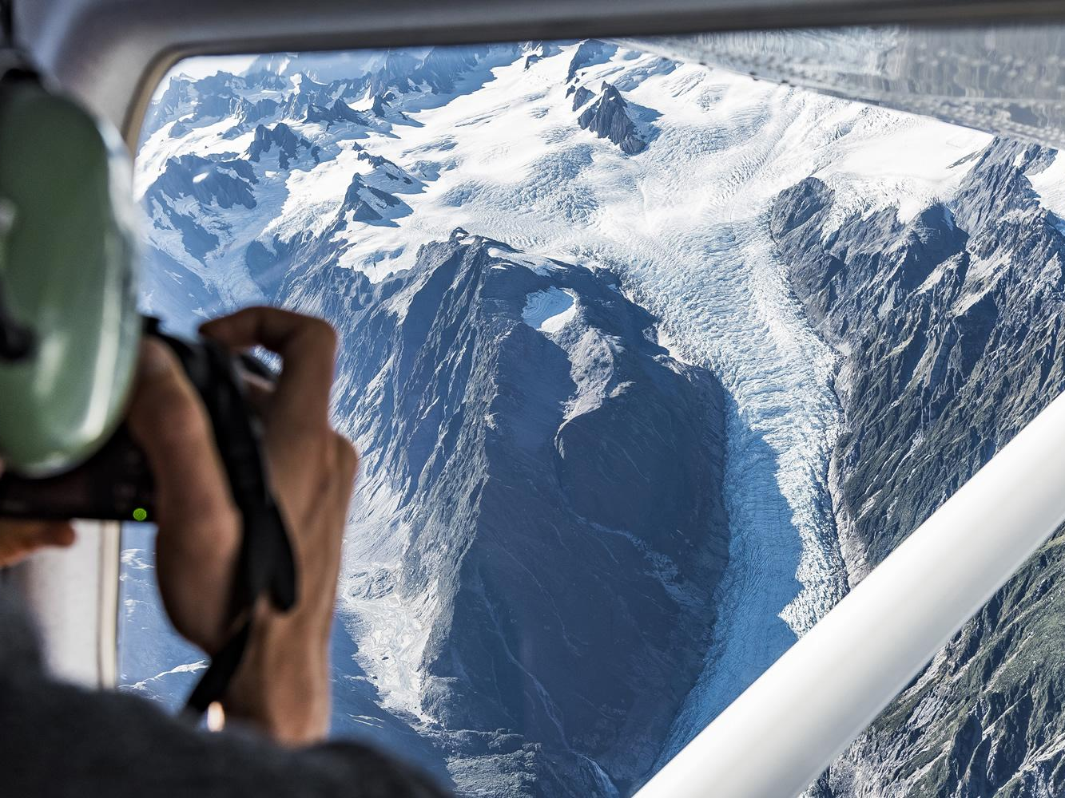
Tools to monitor climate: glaciers
A glacier is like a large river of ice that responds to a changing climate. When the climate is cooling, glaciers increase in size and advance further downhill as more snow and ice accumulates. When the climate is warming, glaciers tend to melt and decrease in size, causing them to retreat uphill.
Scientists can study these movements of glaciers, as well as the markers they leave on the landscape as they retreat (such as piles of rock called moraines), to understand changes in our climate.

Slide 6
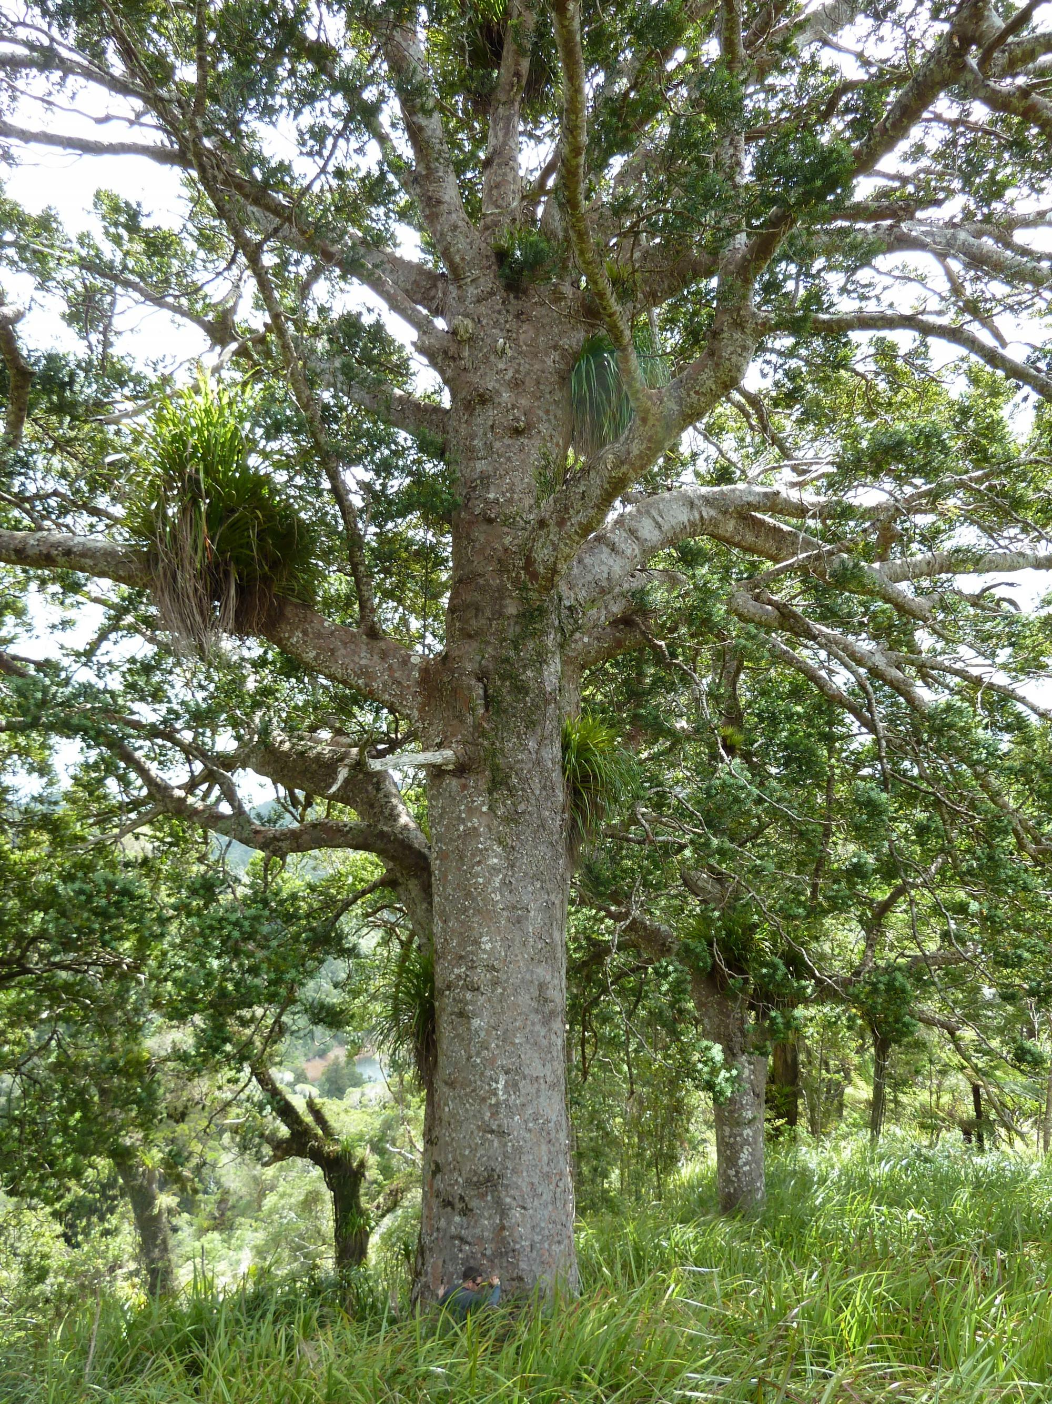
Tools to monitor climate: tree rings
Studying growth rings in a tree can tell us how old a tree is, and sometimes what the climate was like during each year of its life. The width of a tree ring may depend on environmental factors such as temperature, rainfall and soil moisture. Scientists can use this information to reconstruct past climates.
The Kauri tree, which only grows in northern New Zealand, is one of the best tree species in the world for doing this kind of research as they live for a very long time and sometimes have over 1000 rings!

Slide 7
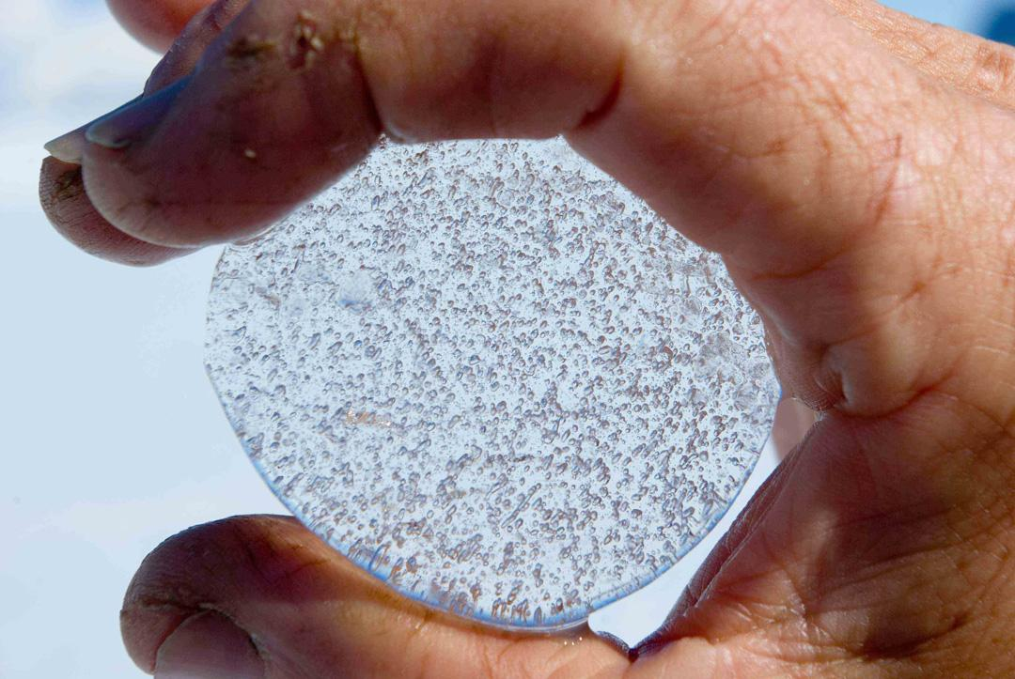
Tools to monitor climate: ice cores
An ice core is a sample of ice taken from a sheet of ice or from a glacier.
Scientists use ice cores to understand the temperature and the amounts of different greenhouse gases in the atmosphere at the time the snow fell and froze to become ice.
Ice cores can be really helpful because they can help us understand past climates hundreds of thousands of years ago.

Slide 8
Kahoot quiz: Past climate can help predict the future
https://play.kahoot.it/v2/?quizId=d1fd7c38-a8fe-40f7-9b3d-cef635f283b8

