Slide 1

Our planet is warming
Rangi weather and climate curriculum

Slide 2
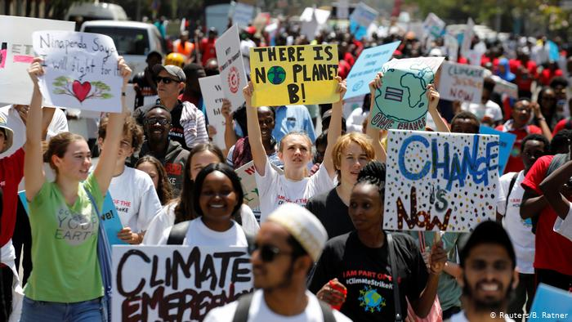
In the last few years, we’ve been hearing a lot about climate change. We read about it in the news and on social media. When we talk about the future, we often talk about climate change.
You might have even been to a school protest about climate change, alongside hundreds of thousands of other young New Zealanders.

Slide 3
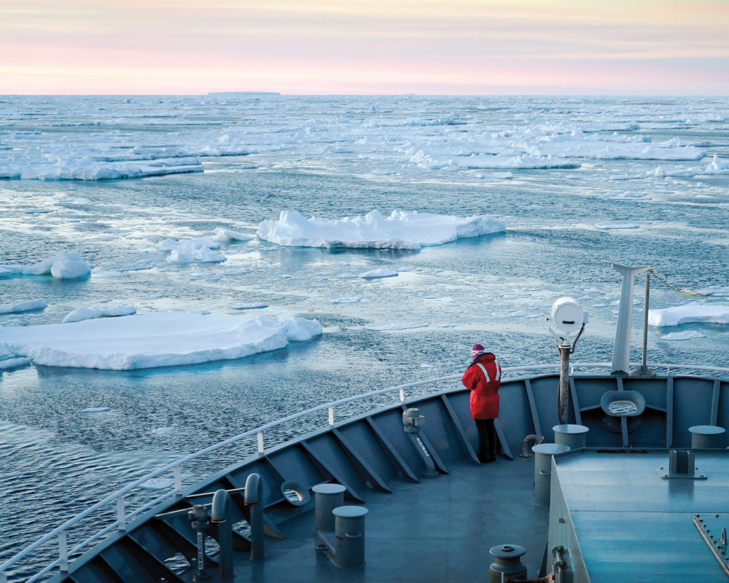
What is climate change and how does it work?
Climate change is the phrase used to describe the long-term warming of the planet and increase in extreme weather, caused by increasing amounts of greenhouse gases in the air.
Our understanding of climate change is based on more than 50 years of scientific studies from all around the world.
While there have been periods of natural cooling and warming throughout the Earth’s history – ice ages, for example – the Earth’s climate is warming faster than ever before.

Slide 4
Greenhouse gases and the greenhouse effect
The atmosphere is the layer of gases (known together as air) that surrounds the Earth. It is kept in place by gravity. Imagine the atmosphere as a large bubble of different gases that surrounds the planet.
The Earth's atmosphere helps protect all living things from harmful radiation from the sun and space. It keeps the Earth warm by trapping a certain amount of heat. If there was no atmosphere, most of the sun's heat would be reflected back into space and much of the Earth would be frozen.
A greenhouse gas is a gas in the atmosphere that absorbs heat energy from the sun.

Slide 5
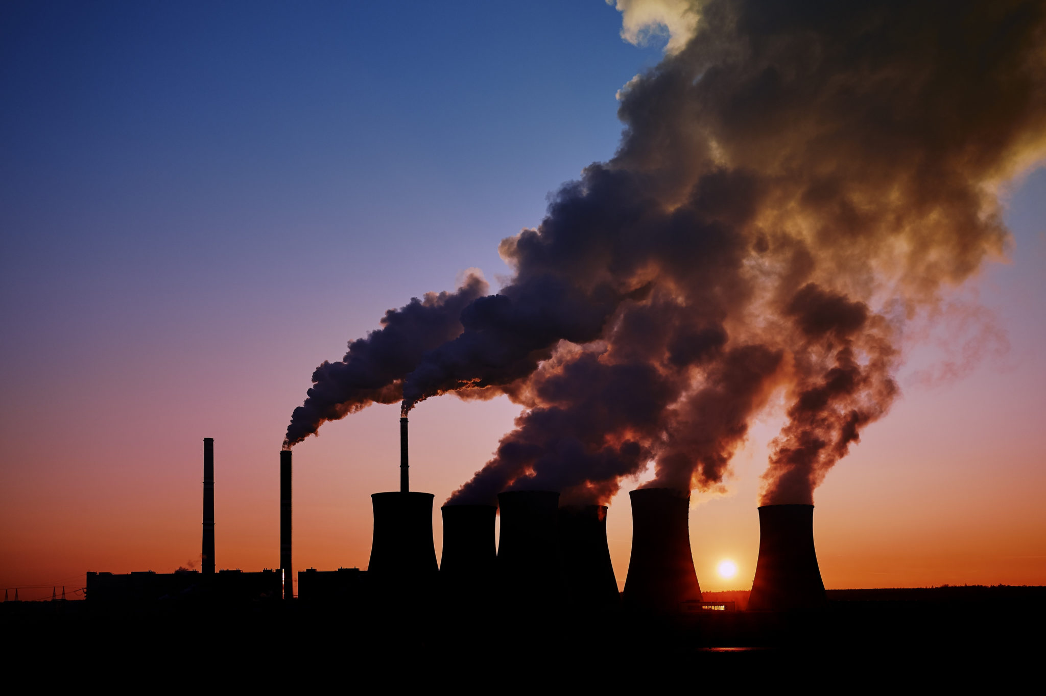
Natural and man made greenhouse gases
Some greenhouse gases, including carbon dioxide (CO₂), methane, water vapour and nitrous oxide are found naturally in the environment.
But when the Industrial Revolution began in the late 1700s, humans began to emit far greater amounts of greenhouse gases from activities like burning coal and oil for transport and industry, cutting down forests and an increase in land used for agriculture.

Slide 6
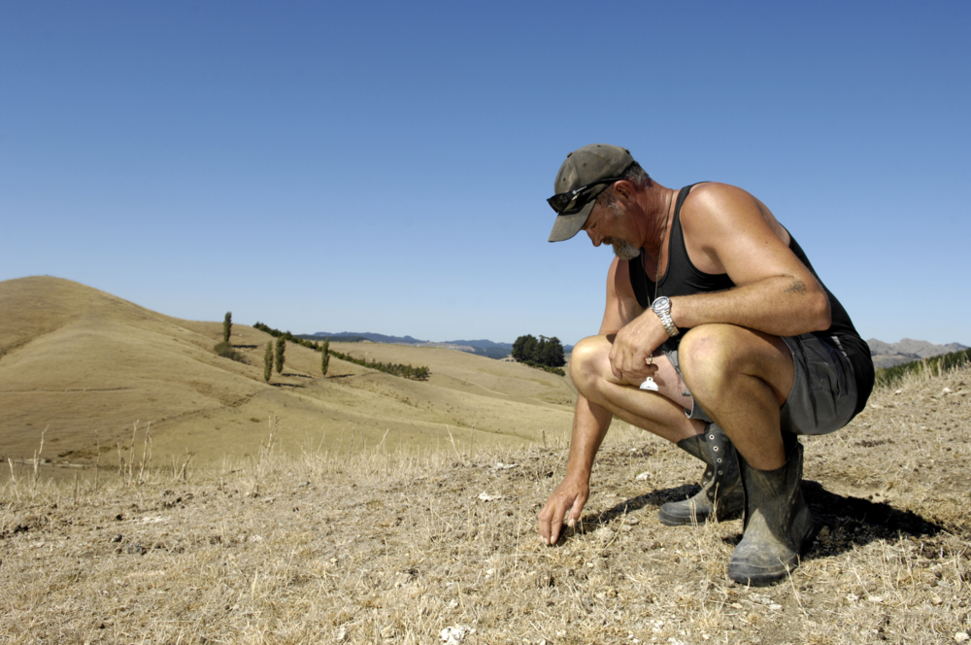
Natural and manmade greenhouse gases
These human activities are responsible for producing greater quantities of greenhouse gases than occur naturally.
The greenhouse effect is caused when these extra gas molecules cause more of the sun’s radiation and heat to be pushed back down to Earth, rather than escaping into space. This is the underlying cause of our warming global climate.

Slide 7
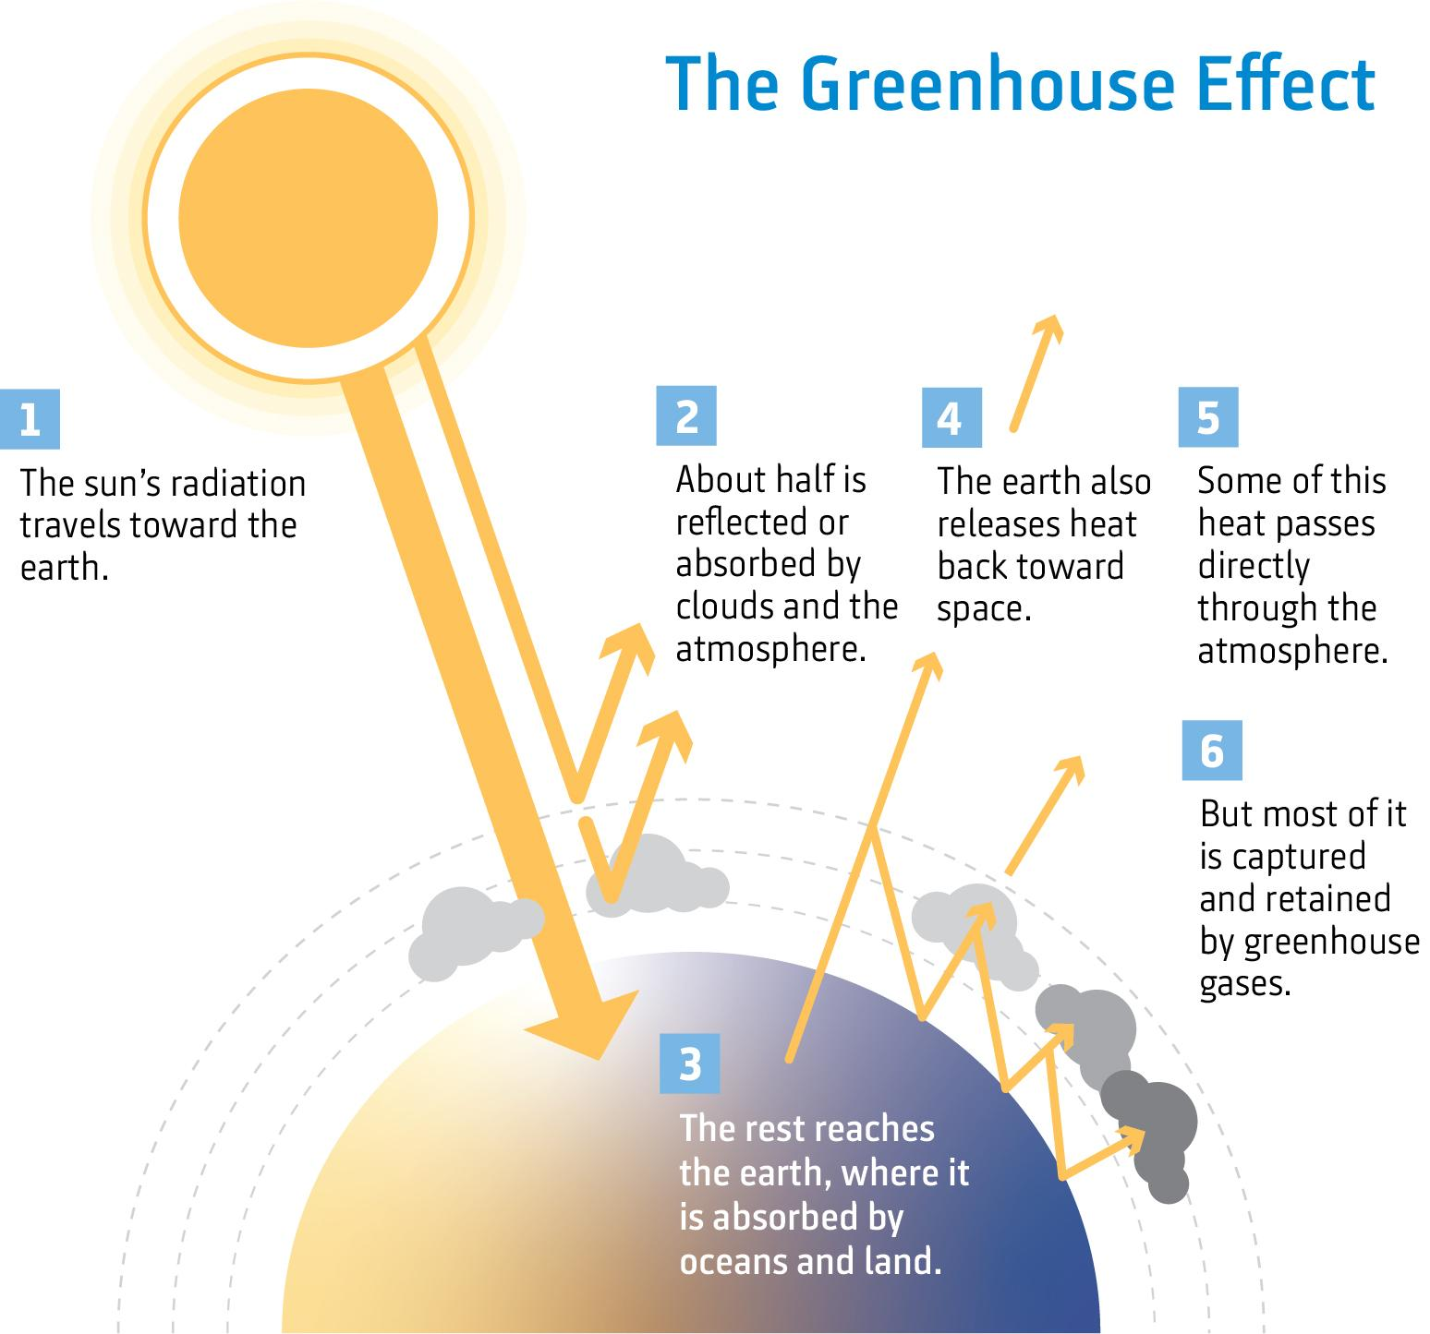

Slide 8
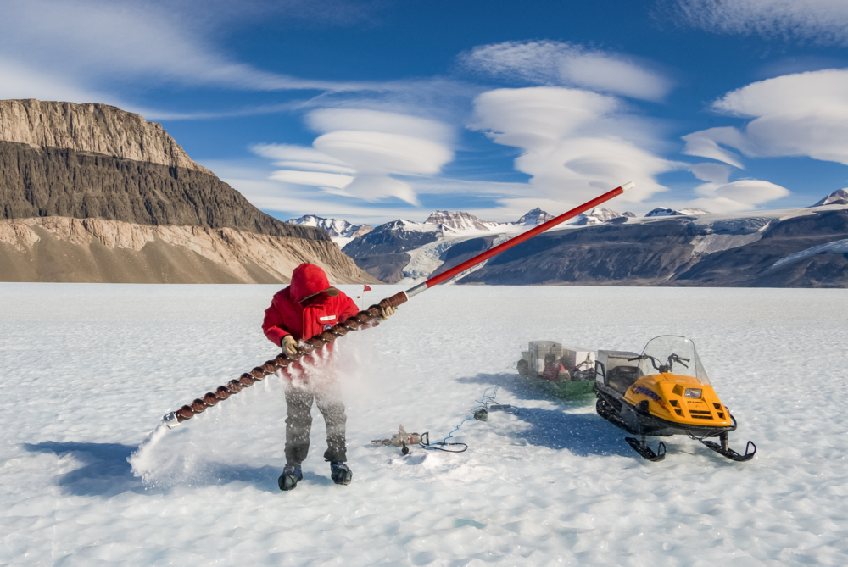
Carbon dioxide
Carbon dioxide (CO₂) is the main greenhouse gas linked to human activities and therefore driving climate change worldwide.
In the past, CO₂ levels have naturally gone down with ice ages and up during interglacial (between ice ages) periods. Scientists know this from studying air bubbles trapped in ice in places like Greenland and Antarctica.

Slide 9
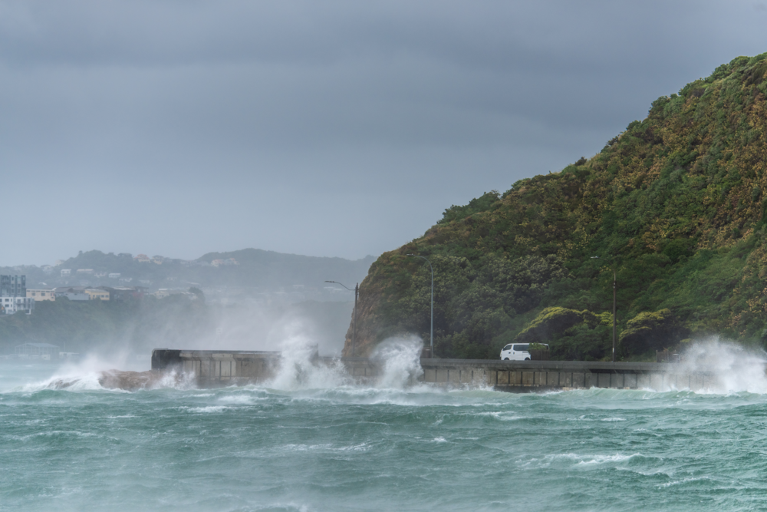
Global impacts of climate change
Increasing temperatures
Changing rainfall patterns
More frequent droughts
More heatwaves
More extreme storms
Sea-level rise

Slide 10
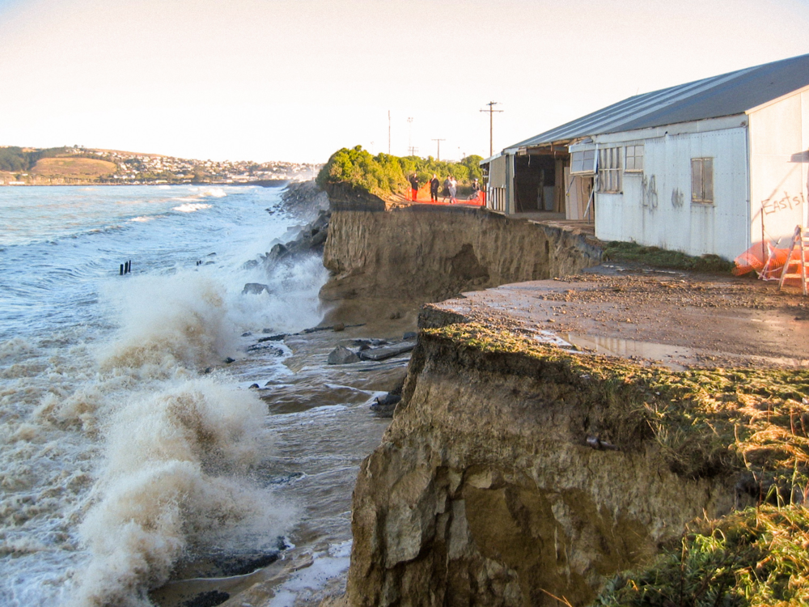
How does sea-level rise?
Melting of ice sheets in Antarctica and the Arctic
Ocean water expands as it warms, causing sea level to rise
Sea-level rise is a concern for low lying coastal communities, causing increased flooding and erosion

Slide 11
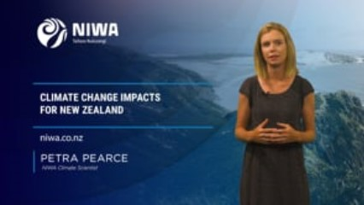
Watch this video to learn about
New Zealand climate change impacts!
https://vimeo.com/392580801

Slide 12

Kahoot quiz: Our Planet is Warming
https://play.kahoot.it/v2/?quizId=d9d80b7c-b398-4ed7-8cdd-98a3ab6cd947

