Slide 1
Climate Change Adaptation Toolbox
https://niwa.co.nz/climate/information-and-resources/climate-change-adaptation-toolbox

Slide 2
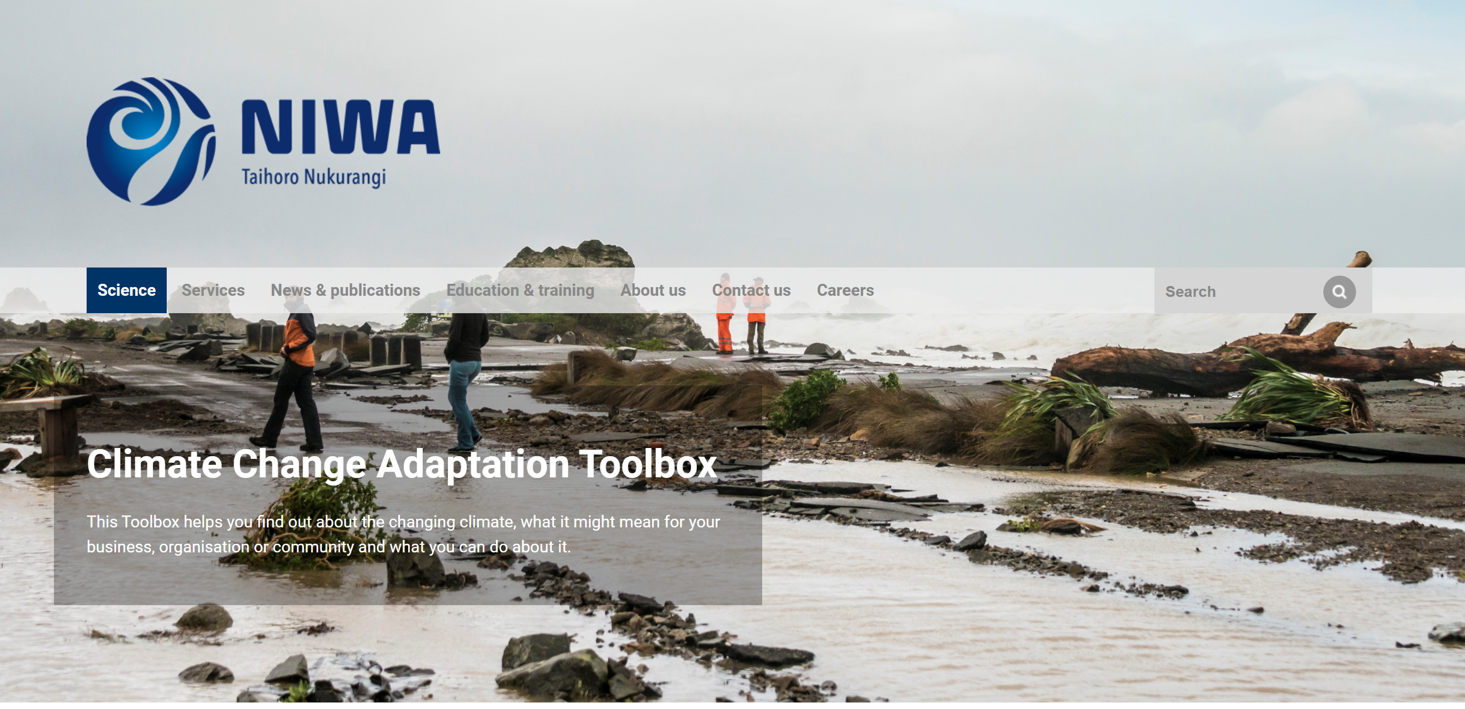
This Climate Change Adaptation Toolbox helps you find out about the changing climate, what it might mean for your school or community and what you can do about it.
https://niwa.co.nz/climate/information-and-resources/climate-change-adaptation-toolbox

Slide 3
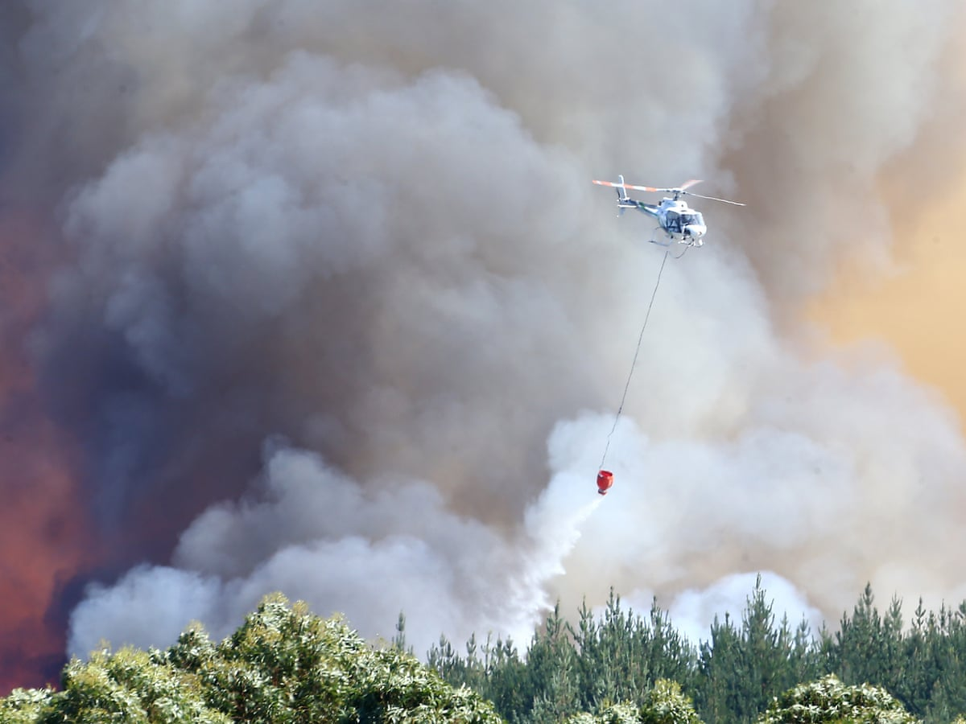
Climate Change Adaptation
Climate change is expected to cause variation to temperatures, rainfall, storm intensities and sea levels.
Climate change adaptation is managing the risk of climate change.
Planning can help maximise benefits and minimise costs.

Slide 4
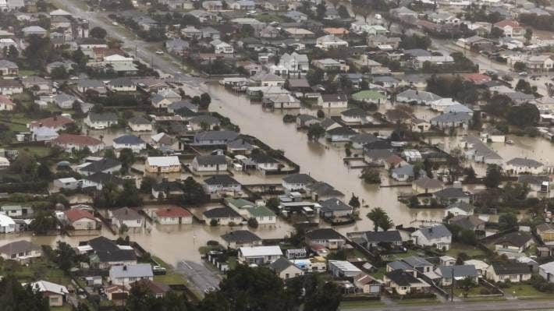
What can the Toolbox be used for?
Education
To find out how my climate is changing
Adaptation to climate change

Slide 5
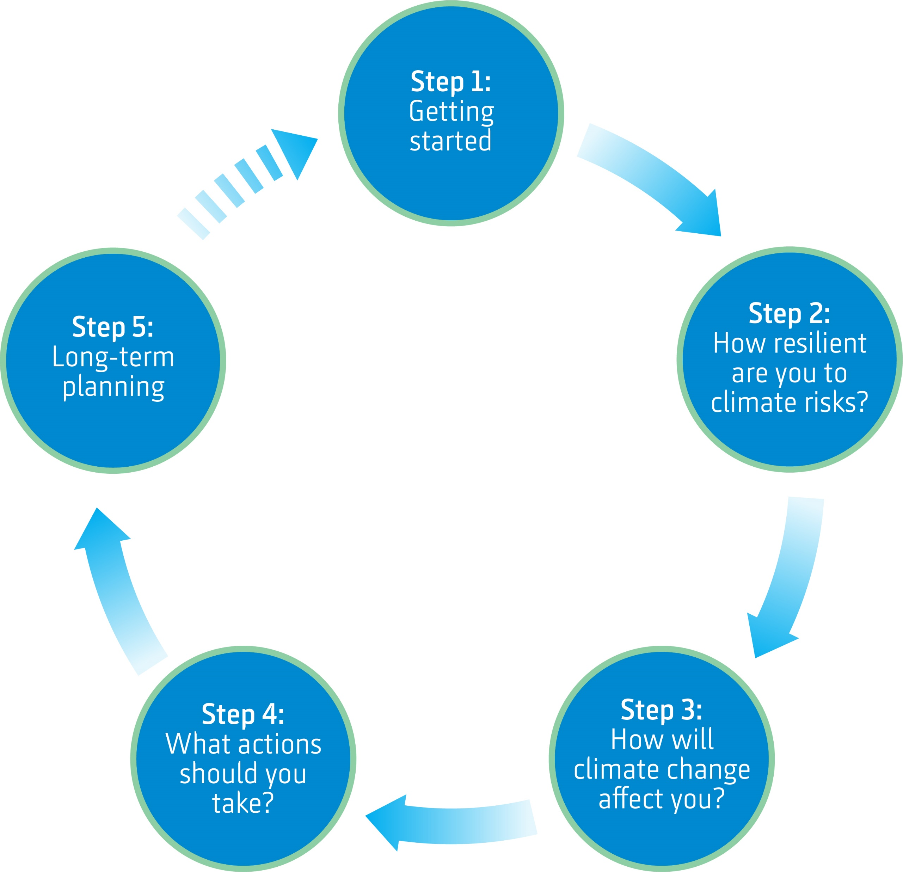
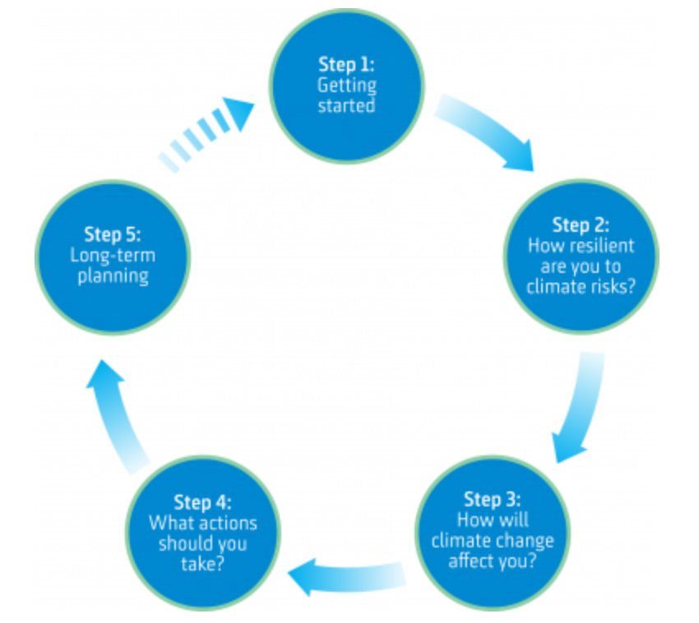

Slide 6
Together we are going to decide what to do ….

